Slide 1
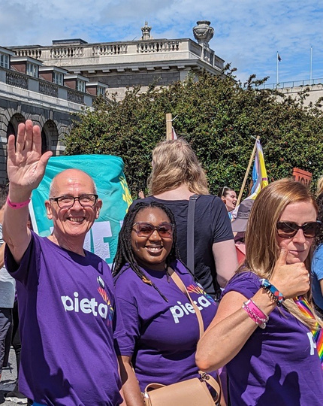
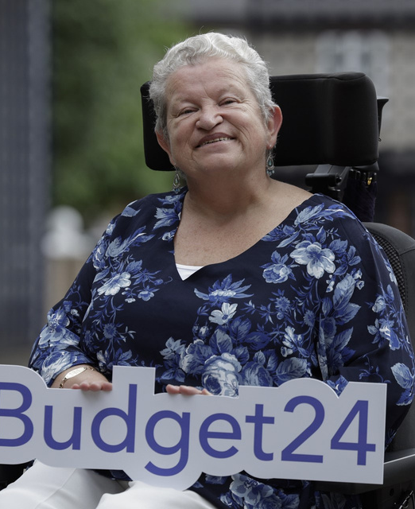
The Importance of Telling Volunteer Stories

Slide 2
LOCAL SPORTS CLUBS ARTS CULTURE HOUSING HEALTH DISABILITY ELDER CARE TIDYTOWNS FAMILY RESOURCE CENTRES BEACH CLEANS ANIMAL RESCUE ADVOCACY ADULT EDUCATION RESIDENTS' ASSOCIATIONS NURSING HOMES THEATRE COMMUNITY DEVELOPMENT OUTDOOR RECREATION SOCIAL ENTERPRISE ENVIRONMENT COMMUNITY GARDENS HELPLINES MENTAL HEALTH LGBTQ+ YOUTH CLUBS INTERNATIONAL
DEVELOPMENT MIGRANT SUPPORT HUMAN RIGHTS PARENT SUPPORT CHILDREN'S WELFARE

Slide 3
This is Paul

Slide 5
Campaign Research
30% of our public survey participants said they have volunteered with a charity in the past year, A further 17% said someone in their household volunteered.
21% said they have volunteered with a community group, 15% said someone in their household.
52% say volunteering is something they do or would personally get a lot out of.
52% said in an ideal world we wouldn’t need volunteers.
49% said giving time to an organisation is more valuable than donating money (8% disagreed).
The biggest deterrent to volunteering is not having enough time - 36%.
Other deterrents include not knowing enough about volunteer opportunities (16%), not being asked (16%,) not finding an opportunity that suits (15%), not being clear about the benefits (10%).
Lots of confusion around who is and isn’t paid, and who should and shouldn’t be paid.

Slide 6
Telling Volunteer Stories
Individual stories can have big impact
Avoid the generic and include personal anecdotes
Communicate the skills of volunteers
Share the motivations of your volunteers
Show the behind the scenes of their roles
Discuss the impact of their roles
Take lots and lots of photos!
Encourage them to talk about what they gain from their experience

Slide 7
Volunteering Video

Slide 8
Visit WeAct.ie/Get-Involved
Send us your stories
Sign up to the Good News Gazette and send good news our way - weact.ie/subscribe
Follow the campaign on social media @WeActIreland –share what we post or use the hashtag #WeAct
Get your teams involved in the campaign – download the toolkit, use our templates, put our posters up in offices and public spaces, add our logo to your website
Take the We Act Pledge
Come along to our training and our events
Get involved with our calls to action

Slide 9
Any Questions or Feedback?
Email:
info@WeAct.ie
Visit:
WeAct.ie/get-involved

