Slide 2
What is Loneliness?
National Strategy for Reducing Loneliness in Denmark
How FriSe work with the strategy to reduce loneliness

Slide 3
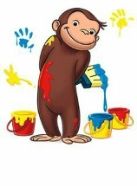
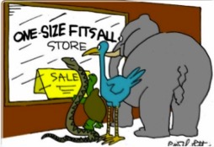

Slide 4
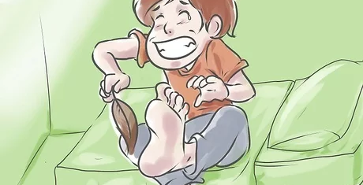

Slide 5
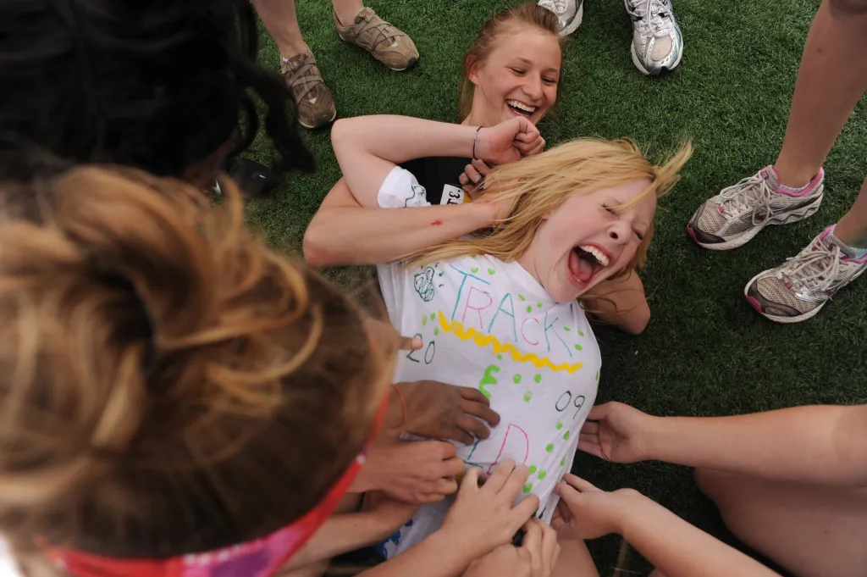
Other people – fun and/or fear

Slide 6
Other people – fun and/or fear
We are social beings with a fundamental need to bond with others, to belong and to be of value for others.
The word relation comes from the Latin "relatum", which means "carry". We carry each other, support and help each other and are responsibility to each other.
That’s what loneliness is all about: Many things in our life depends on other people, interactions, relations, and the nature of our relations.
We need them so bad, and they can hurt us so bad!
Loneliness: Often not about numbers but how we are treated by others and the quality of our relations and the communities in our everyday life.

Slide 7
Loneliness is a global health threat
“Anyone, anywhere, can be lonely or socially isolated. Across all ages and regions, loneliness and social isolation have serious impacts on our physical and mental health, and the well-being of our communities and society.”
WHO: Declared in 2023 loneliness a global health threat
One in four older people experience loneliness in all regions and between 5­­–15% of adults.
In Denmark About 10% of adults feels lonely - 470,000 adults over the age of 16.
Ireland???

Slide 8
What is loneliness
Research definition:
“A subjective, unpleasant emotion that arises from a mismatch between desired social relationships and actual relationships.”
My needs for social contact and relations are not meet.

Slide 9
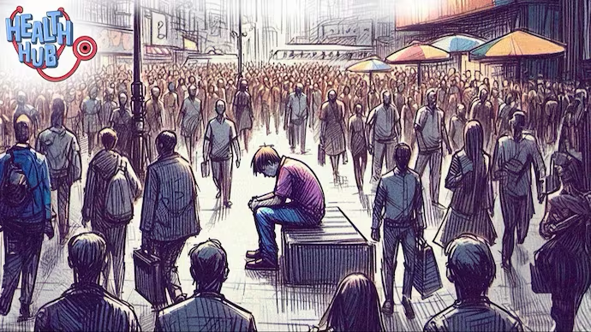
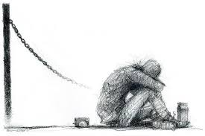
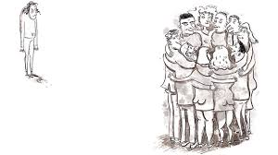
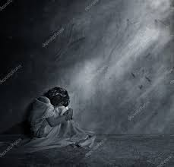

Slide 10
Missing
I miss somebody to be with, somebody to do stuff with, to talk with
I miss confidants or someone to share my innermost thoughts, feelings and experiences with I miss mutual and close relationships and cohesion and understanding from others I miss someone that I can count on I feel alone with my problems I feel let down by others
I feel invisible, unwanted, misunderstood and of no value to others I feel emptiness, pain, sadness, shame, loss and grief I have lost the sense of meaning and value in life - doesn't it even matter if I'm here?
And a lot of other feelings…

Slide 11
What is loneliness
It relates to the number and to the nature or quality of social relations.
It’s a feeling, its about our expectations, needs and assessment of own social relationships.
A difference between loneliness and social isolation: You can be alone much of the time without feeling lonely or be with people and feeling like the loneliest person in the world.
Often it’s experienced most strongly in the company with others.
Loneliness and social isolation are linked, but it’s hard to say which way the arrow point; are you lonely because you are socially isolated, or have you isolated yourself because you feel lonely.

Slide 12
Long-term loneliness
The feeling is a natural part of life and comes in different life situations with different intensity and duration.
Becomes long-lasting: Major consequences on well-being, physical and mental health - and for society as a whole.
An evil circle: May affect the personality, behaviour, social skills, expectations or approach to other people
- they can begin to withdraw more and more from social contexts and relationships, which makes it even harder to create good relationships or to be part of a community.

Slide 13
Causes or increased risk of loneliness
Living alone – for a long time
Chronic diseases and disabilities
Major physical disability
Mental disorder
Unemployment
Ethnic minority background
LGBT+ people
Relatives of people with a protracted illness
In some of these situations, it can be difficult to maintain attachment to networks, relationships, labour market or communities.

Slide 14
Different types of loneliness
Social loneliness: Miss someone to be with or to do something with in everyday life
- the number of contacts/relationships or the opportunity to be with others has changes by moving to a new city, school or with lockdown during the Covid-19 pandemic.
Emotional loneliness: Miss someone to share your innermost thoughts, feelings, and experiences with and miss close relationships where you feel you are seen, heard, and understood.
- mostly about the quality of one's relationships.
Existential loneliness: Miss or lack a deeper meaning in life and feel completely alone with questions about life, death, and your hole existence
– often in major life transitions or life crises, such as a disability, a mental illness, a divorce or the loss of a dear one.

Slide 15
Loneliness and civil society
Research shows that inclusive communities can promote well-being, increase connection with others, and create hope and meaning in life.
Research also shows that being a volunteer can strengthen your mental health, because here we contribute and have meaning for others and feel part of something bigger.
However: A big study in Denmark shows that the effect of expanding your social networks is less compared to the effect of other strategies such as social support, social and emotional skills training and psychological treatment.
Not just widening one's social circle by by participating in activities with others or being part of a community or , but missing close relationships, the cohesion with the others – to feel seen, heard, understood, and accepted as you are.

Slide 16
National Strategy for Reducing Loneliness in Denmark
Goal: 50 precent less loneliness in the population (+16 years) by 2040

Slide 17
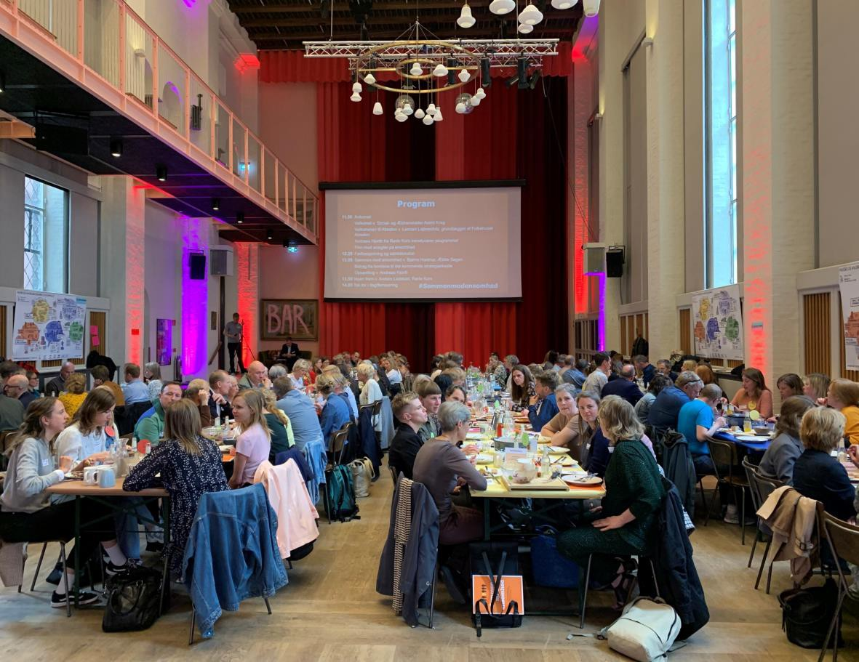
Develop in a broad collaboration
The Red Cross and “Ældre Sagen”, two of the largest voluntary organizations in Denmark, got money from the state to facilitate a process where representatives from voluntary organizations, municipalities, foundations, the business community, trade unions and politicians discussed a new national strategy.
Kick-off event with 166 participants, including then Minister for Social Affairs and the Elderly Astrid Krag
12 workshops with 300 participants
Two rounds of consultation among the stakeholders of the partnership

Slide 18
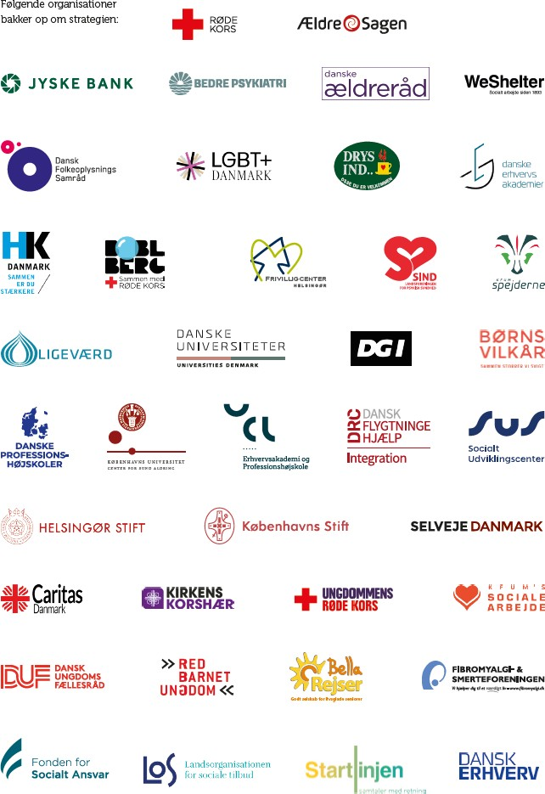
115 organisations signed the strategy

Slide 19
Structure
The strategy is based on five areas where loneliness can occur and must be prevented or reduced within:
Home and residence Day care
School and education
Leisure and communities
Working life and employment
Health and care
It describes 75 initiatives within different life arenas.
Voluntary organisations play a crucial role in the "Leisure and Communities" arena, but also play an important role in other arenas.

Slide 20
Notes:
På tegningen kan I se, hvordan vi arbejder på ”samfundsniveau” – det vi også har kaldt tværgående fokusområder. Og så de resterende fem livsarenaer (hjem og bolig, sundhed og pleje, osv.) Det, der klassisk kan betegnes som ”socialområdet”, indgår i alle arenaer. Tanken er, at vi skal sætte ind med initiativer på tværs af alle de områder og omstændigheder, vi som mennesker færdes i og under.

Slide 21
Recommendations across the arenas
Better overview of activities and communities locally
More activities and offers aimed at lonely people
Strengthen funding for voluntary organisations
Strengthen access to communities – support the path to a community, for example by community guides
Strengthen the work of voluntary associations around hosting and how to welcome new participants
Make volunteer organisations and communities more inclusive
Better cooperation and link between municipal activities and civil society:
between health professionals, psychiatry, doctors, housing associations, nursing homes, residential homes, schools, education and civil society – so they can support and refer citizens to a voluntary organisation or community.

Slide 22
How FriSe work with the strategy to reduce loneliness
Building bridges to volunteer communities

Slide 23
Purpose
We want many more people to have the opportunity to participate in self-chosen and meaningful activities and contribute as active citizens with the resources they may have in a given time in their life.
We want to increase their social network, well-being, and quality of life.
We want to promote inclusive communities and more sustainable bridges between communities and those who do not participate in activities or volunteer because of different barriers.
We want a much better cooperation between organisations and between the public sector and the civil society – because we can’t do it alone.

Slide 24
Helping citizens in their current life situation – building bridges between citizens, civil society and municipalities

Slide 25
Website that provides voluntary social services and non-targeted municipal services
Citizens and relatives can look for help and support or a community
Public sector employees can get an overview, so they more easily can refer citizens to a activity, a volunteer organisation or community.
Voluntary organisations can make their activities visible and get an overview themselves so they can refer to other associations.

Slide 26
Building bridges to volunteer communities

Slide 27
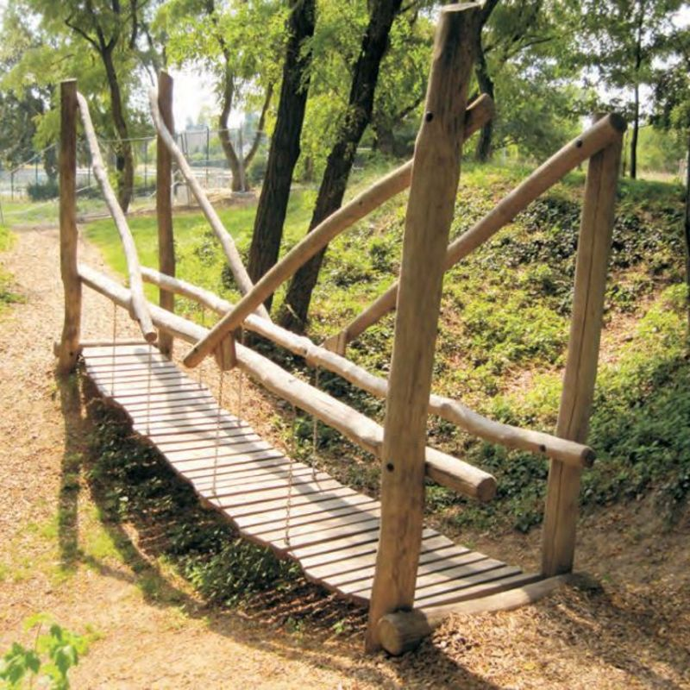
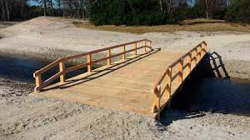

Slide 28
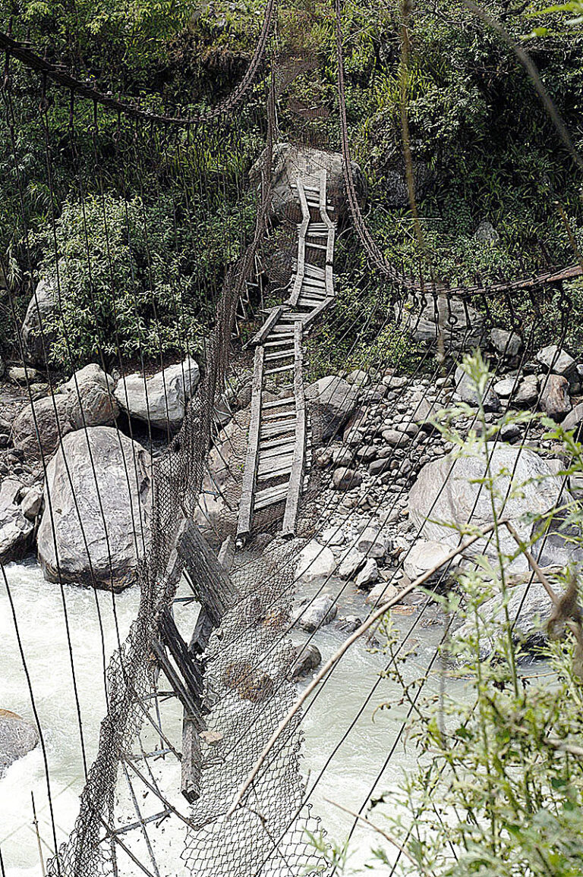
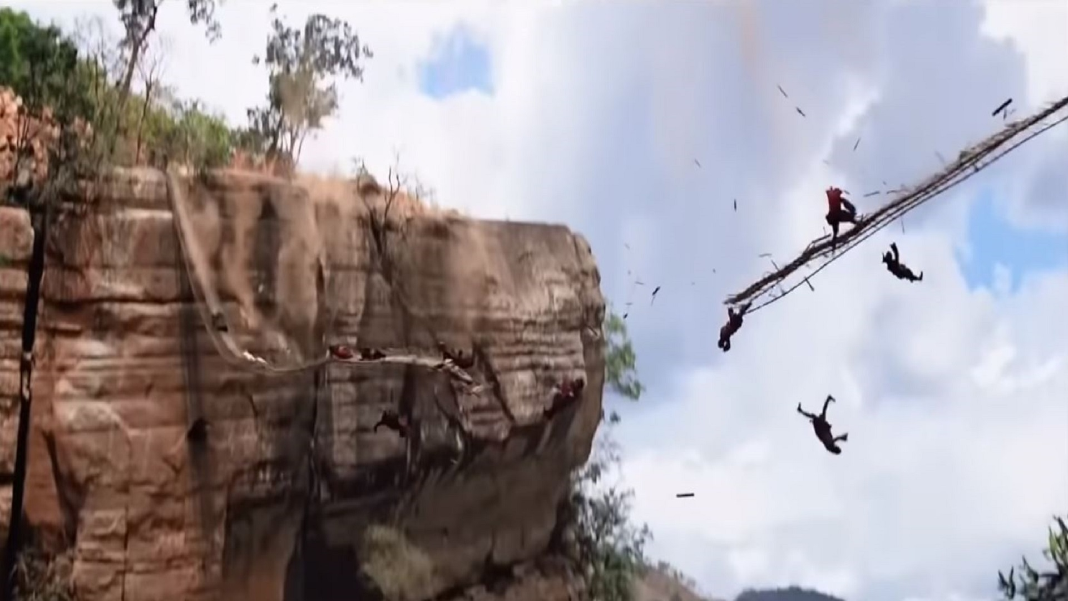

Slide 29
Building bridges
Bridgebuilding is overcoming obstacles and barriers by creating sustainable bridges between people and communities:
People's path: From feeling outside into a organisations or social activities where they can receive support, participate in activities, or become a volunteer.
Organisations: Their hosting and inclusion of the individual as a valuable and equal participant.
Building bridges between organisations and between sectors

Slide 30
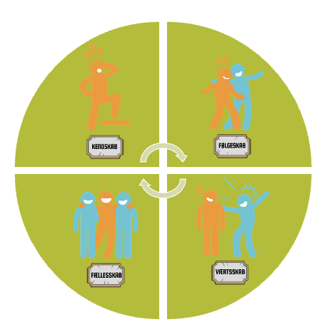
At guide with four key elements
Opportunities: Overview and knowledge of volunteer organisations, communities and how to motivate participation.
Fellowship: Support the path towards participation through guidance and personal support on the road from “home” to community.
Hospitality: Create a warm welcome and a safe environment.
Inclusion: Making sure the individual can participate on their own terms, feel like a valuable part of the community and can create social relationships with others.

Slide 31
Opportunities
Create a broad overview of opportunities in the local community; of organisations/voluntary communities and social activities.
Get in contact with the target group
Spreading awareness through a large contact surface and communication on social media, local press etc.
Know the range of opportunities and activities
- a wide range of offers makes it easier to match the individuals wishes, needs and resources.
Make it available online so it can be used by citizens them self or by relatives, organisations, doctors, healthcare workers, employees in the public service, so they can refer the citizen to an offer when talking to them.
Collaboration with or referral from people who are already in contact with and know the target group - relatives, associations, public servants, doctors, psychologists, healthcare workers, schools etc.
Outreach work to places where the target group comes or is located

Slide 32
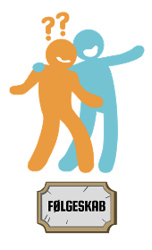
Fellowship
Conversation and match with a community: Find out together with the citizen his/her wishes, needs, resources and barriers.
Practical companionship: Easy information about the community that guides the citizen on how to get there, where to meet, where the entrance is, what they should bring, who will meet them, etc. Maybe use pictures.
Personal companion: A person who picks up and follows the citizen to the community and possibly stays there. In this way, the participant can get the necessary physical and mental support to move from home to the activity.

Slide 33
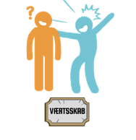
Hospitality
The good welcome starts in ”fellowship" with the conversation and information receive beforehand.
It is important to have a "welcome person" who takes responsibility for building a trusting relationship:
Thorough introduction to the organisations, community, the other participants, activities, etc.
Insight into wishes and needs to meet challenges and provide the right support - mutual alignment of expectations.
Follow up – can feel like new for a long time...

Slide 34
Inclusion
The participants must experience room to "be themselves" and to participate on their own terms - and feel a sense of belonging with the others.
Flexible participation options:
Offer different roles or degrees of participation and commitment based on interests and wishes.
Participate in an activity or as a volunteer - or a combination in between where they can switch between roles.
Adapt to the individual interests – do not have too fixed a framework for an activity.
Bridge into new communities if and when needed...

Slide 35
Support groups for lonely people
For people who need to process their loneliness with peers by sharing thoughts, experiences and experiences with each other.
In this way, they can mirror themselves in each other, together create a better understanding and acceptance of their loneliness.
And help each other reach out to communities outside the group.
A concept with ten themes to talk about in the group, for example: What is loneliness to you, causes for loneliness, everyday life with loneliness, meeting (new) people and reaching out to others or to communities outside the group.

Slide 36
"It's quite strange, but already after the first time in the group, when I discovered that eight others were also lonely, it was already a bit easier. Talking about your problem and hearing other people's experiences makes it a little less dangerous. Now I regret that I didn't do something about my loneliness years ago – it's lasted pretty much my whole life – but it will diminish in the future."
"It's really transgressive to acknowledge this feeling and say it out loud. Before participating in the group, I could hardly think of anything other than feeling lonely. But it was as if a plug popped off when I started telling. It was very liberating."

Slide 37
Last points
Create awareness of how big a problem loneliness is - w
We need to talk much more about loneliness to make it a normal part of our conversation, so we have the courage to talk about our loneliness or to ask others about their loneliness.
We need a lot more offers or activities aimed at the lonely
We need to bridge-building to voluntary communities and to work with reel inclusion.
And not least, for us to come together and collaborate across organisations, across civil society and the public sector.

