Slide 1
Stop Under-reporting Your Impact
It’s much more
than it appears!

Slide 2
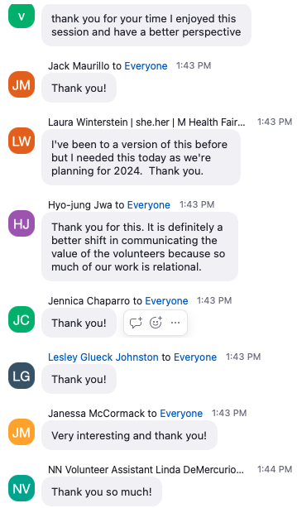
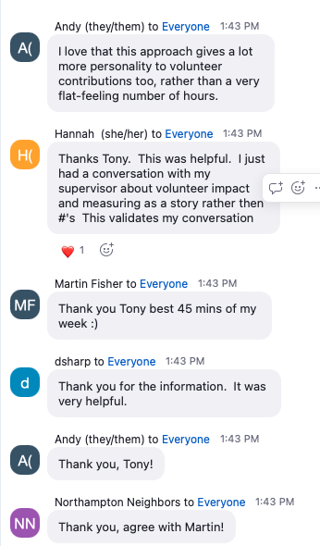

Slide 3
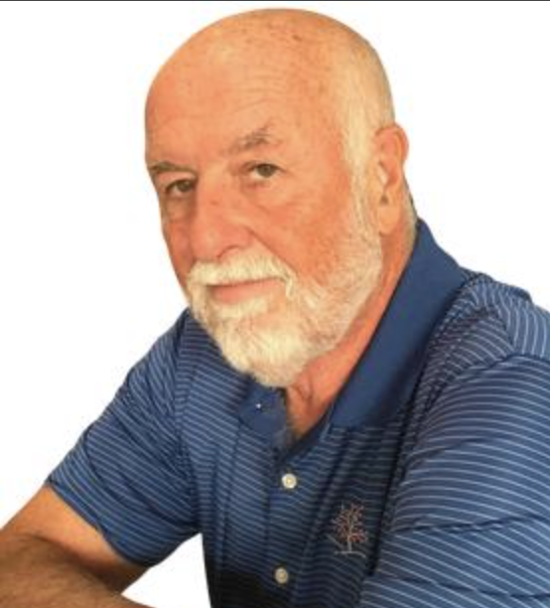
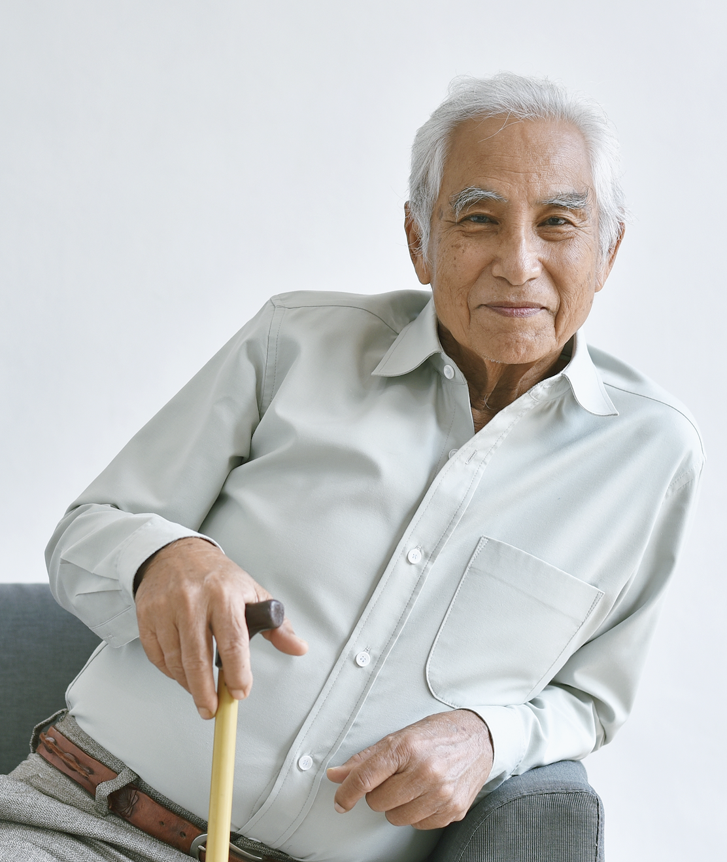
The Wage Replacement Value
of Peter’s time (2 hours x $30)…
$60
The value his client saw
(2 taxis @ $85 each way)…
$170

Slide 4
The Wage Replacement Value
of Peter’s time (2 hours x $30)…
$60
The Service Replacement Value
(2 taxis @ $85 each way)…
$170

Slide 5
The Wage Replacement Value
of Peter’s time (2 hours x $30)…
$60
The Service Replacement Value
(2 taxis @ $85 each way)…
More than $170
Notes:
Also appreciate having him back because he missed their conversations during the drive

Slide 6
Volunteer Hours Report
YEAR HOURS TREES
2022 10,000 1,000,000
2021 9,000 1,000,000 2020 8,000 1,000,000
Notes:
POLL 1
1. If I asked the upper management at your organization which year represents your best year, which would they say?
2022
2021
2020
Don’t know

Slide 7
Volunteer Hours Report
YEAR HOURS TREES
2022 10,000 1,000,000
2021 9,000 1,000,000 2020 8,000 1,000,000
POLL 1
If I asked the upper management at your organization which year represents your best year, which would they say?
2022
2021
2020
Don’t know
Notes:
POLL 1
1. If I asked the upper management at your organization which year represents your best year, which would they say?
2022
2021
2020
Don’t know

Slide 8
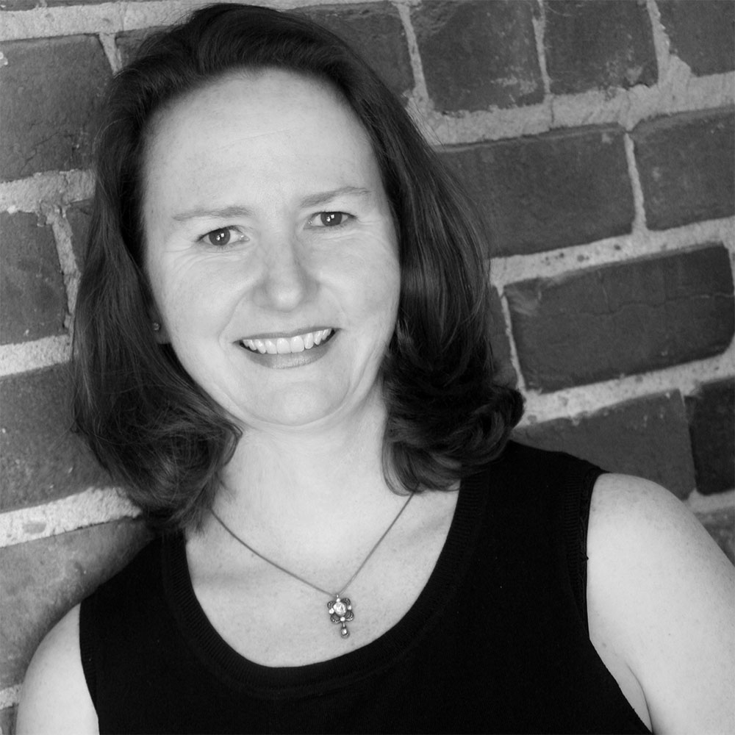
Dr Sue Carter Kahl
“The widespread use and legitimacy of wage replacement rates can obscure the need to capture volunteer impact in other ways.”

Slide 9
Notes:
The measurement of Volunteer hours has value as a reporting tool.
But its not the only tool available to you, and just like this shovel and rake both have great value in the garden, it's important to use the right tool for the job at hand.
For many organizations, the only tool available to them to demonstrate value to the community has been a record of volunteer hours contributed. But like I said, there's another tool available for you to use. This other tool, that starts with answering mission related questions is your key to truly demonstrating the value of what you bring to the community.
The beneficial value to the community is more accurately reported as the output of volunteer activity rather than the input of volunteer hours.

Slide 10
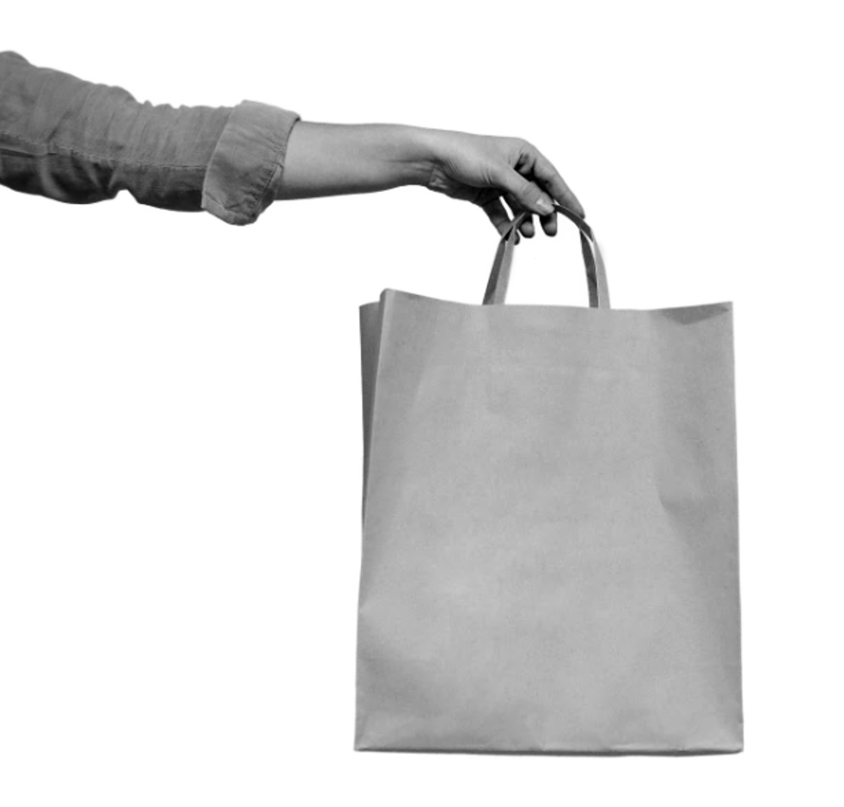
Takeaways
For reporting value to the community, focus on OUTPUTS rather than inputs.

Slide 11
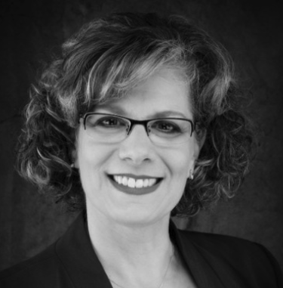
Beth Steinhorn
“Volunteers don’t serve because they want to reach a quota of hours; they volunteer to make a difference for a cause they care about. Tracking hours tells nothing about whether they’ve succeeded in making that difference.” © Beth Steinhorn

Slide 12
Notes:
How many rides - NOT the value of a taxi

Slide 13
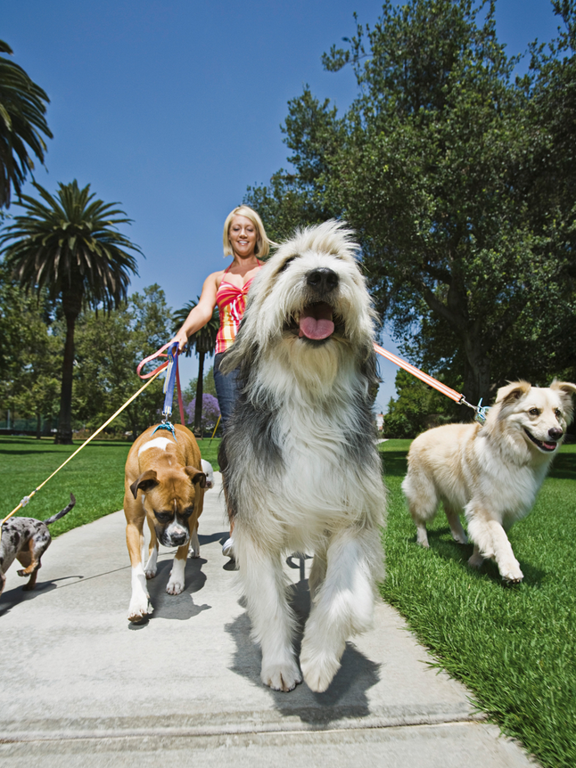
Notes:
How many dogs were carried for, or even how many were give daily walks, - NOT the value of a dog walk

Slide 14
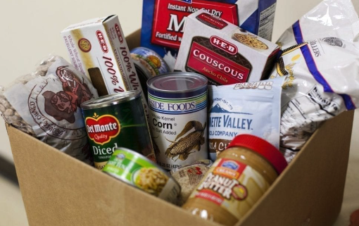
Notes:
How many pounds of food got distributed NOT …

Slide 15
Notes:
How many people were assisted - NOT… POLL 2
2. What percentage of your volunteer roles involve measurable outputs?
0-5%
6-25%
26-50%
51-75%
76-100%

Slide 16
POLL 2
Roughly what fraction of your volunteer roles involve measurable outputs?
- None
- A few
- Half
- Most
- All
Notes:
How many people were assisted - NOT… POLL 2
2. What percentage of your volunteer roles involve measurable outputs?
0-5%
6-25%
26-50%
51-75%
76-100%

Slide 19
FOCUS ON HOURS
 |  | WRV
Volunteer hours | 1,000 | $30
FOCUS ON OUTCOMES
 |  | SRV | BV
Rides provided | 800 | $50 | $40,000
Added value | 800 | $25 | $20,000
Value of the rides |  |  | $60,000
WRV = Wage Replacement Value SRV = Service replacement value CBV = Community Benefit Value
Notes:
Wage replacement value - Both Volunteer Canada and the In dependant Sector (in the United States) peg the value of a volunteer hour at approximately $30.

Slide 20
FOCUS ON HOURS
 |  | WRV | CBV
Volunteer hours | 1,000 | $30 | $30,000
FOCUS ON OUTCOMES
 |  | SRV | BV
Rides provided | 800 | $50 | $40,000
Added value | 800 | $25 | $20,000
Value of the rides |  |  | $60,000
WRV = Wage Replacement Value SRV = Service replacement value CBV = Community Benefit Value
Notes:
Organization Benefit Value
Susan CK

Slide 21
FOCUS ON HOURS
 |  | WRV | CBV
Volunteer hours | 1,000 | $30 | $30,000
FOCUS ON OUTPUTS
 |  | SRV | CBV
Rides provided | 800 | $50 | $40,000
Added value | 800 | $25 | $20,000
Value of the rides |  |  | $60,000
WRV = Wage Replacement Value SRV = Service Replacement Value CBV = Community Benefit Value

Slide 22
FOCUS ON HOURS
 |  | WRV | CBV
Volunteer hours | 1,000 | $30 | $30,000
FOCUS ON OUTPUTS
 |  | SRV | CBV
Rides provided | 800 | $50 | $40,000
Added value | 800 | $25 | $20,000
Value of the rides |  |  | $60,000
WRV = Wage Replacement Value SRV = Service Replacement Value CBV = Community Benefit Value
Notes:
What argument could a senior manager, funder, potential donor give you if you presented the value of the program was was $40,000 per year?

Slide 23
FOCUS ON HOURS
 |  | WRV | CBV
Volunteer hours | 1,000 | $30 | $30,000
FOCUS ON OUTPUTS
 |  | SRV | BV
Rides provided | 800 | $50 | $40,000
Friendly visit added value | 800 | $25 | $20,000
Value of the rides |  |  | $60,000
WRV = Wage Replacement Value SRV = Service Replacement Value CBV = Community Benefit Value

Slide 25
FOCUS ON HOURS
 |  | WRV | CBV
Volunteer hours | 120 | $30 | $3,600
FOCUS ON OUTCOMES
 |  | SRV | BV
Dog baths provided | 250 | $50 | $12,500
WRV = Wage Replacement Value SRV = Service replacement value CBV = Community Benefit Value

Slide 26
FOCUS ON HOURS
 |  | WRV | CBV
Volunteer hours | 120 | $30 | $3,600
FOCUS ON OUTPUTS
 |  | SRV | CBV
Dog walks provided | 500 | $25 | $12,500
WRV = Wage Replacement Value SRV = Service Replacement Value CBV = Community Benefit Value
Notes:
THIS ONE volunteer did not just donate 3600 worth of her time
She donated over $12000 with of value to the community
POLL 3
3. What percentage of your volunteer roles involve measurable outputs, for which there could be a comparable market value?
0-5%
6-25%
26-50%
51-75%
76-100%

Slide 27
POLL 3
Roughly how many of your volunteer roles involve measurable outputs for which there could be a comparable market value?
- None
- A few
- Half
- Most
- All
WRV = Wage Replacement Value SRV = Service Replacement Value CBV = Community Benefit Value
Notes:
THIS ONE volunteer did not just donate 3600 worth of her time
She donated over $12000 with of value to the community
POLL 3
3. What percentage of your volunteer roles involve measurable outputs, for which there could be a comparable market value?
0-5%
6-25%
26-50%
51-75%
76-100%

Slide 28
Jayne Cravens
“It reinforces the idea that the number of hours contributed by volunteers is the best measure of volunteer program success (quantity rather than quality and impact)”. © Jane Cravens - www.coyotebroad.com

Slide 30
FOCUS ON HOURS |  |  | WRV | CBV
Volunteer hours | 3 |  | $30 | $90
 |  |  | SRV | BV
FOCUS ON OUTCOMES
Doctors | 20 | x | Doctor’s wage for 2 minutes | $63
Nurses | 70 | x | Nurse’s wage for 2 minutes | $27
Orderlies | 50 | x | Orderly’s wage for 2 minutes | $21
Administrators | 5 | x | Admin’s wage for 2 minutes | $10
Total |  |  |  | $120
WRV = Wage Replacement Value SRV = Service replacement value CBV = Community Benefit Value
Notes:
Why do we have volunteers in the info booth.
It makes it easier for visitors AND
reducing the number of time a member of staff get stopped.
Take the volunteers out and have them tally
What if people just read the signs

Slide 31
FOCUS ON HOURS |  |  | WRV | CBV
Volunteer hours | 3 |  | $30 | $90
 |  |  | SRV | CBV
FOCUS ON OUTPUTS
Doctors | 30 | x | Doctor’s wage for 2 minutes | $83
Nurses | 100 | x | Nurse’s wage for 2 minutes | $37
Orderlies | 75 | x | Orderly’s wage for 2 minutes | $30
Administrators | 10 | x | Admin’s wage for 2 minutes | $20
Total |  |  |  | $170
WRV = Wage Replacement Value SRV = Service Replacement Value CBV = Community Benefit Value
Notes:
What you measure is what you get - ALBERTA EXAMPLE
POLL 4 4. Where applicable, how interested do you think your upper management team would be in seeing the value of your volunteer engagement being presented in a similar manner, based on the value of the outputs.
Not interested at all
Not very interested
Somewhat interested
Very interested

Slide 32
POLL 4
Where applicable, how interested do you think your upper management team would be in seeing the value of your volunteer engagement being presented in a similar manner, based on the value of the outputs.
- Not at all
- Somewhat
- Very interested
WRV = Wage Replacement Value SRV = Service Replacement Value CBV = Community Benefit Value
Notes:
What you measure is what you get - ALBERTA EXAMPLE
POLL 4 4. Where applicable, how interested do you think your upper management team would be in seeing the value of your volunteer engagement being presented in a similar manner, based on the value of the outputs.
Not interested at all
Not very interested
Somewhat interested
Very interested

Slide 34
FOCUS ON HOURS |  | WRV | CBV
Volunteer hours | 1,000 | $30 | $30,000
WRV = Wage Replacement Value SRV = Service Replacement Value CBV = Community Benefit Value

Slide 35
FOCUS ON HOURS |  | WRV | CBV
Volunteer hours | 1,000 | $30 | $30,000
 |  | SRV | CBV
FOCUS ON OUTCOMES
(Free) Festival attendees | 100,000 | $50 | $5,000,000
Incremental Tourism |  |  | $1,000,000
Total |  |  | $6,000,000
WRV = Wage Replacement Value SRV = Service Replacement Value CBV = Community Benefit Value

Slide 37
FOCUS ON OUTPUTS
Girl Scouts alumnae income Non-alumnae income Difference | $51,700 - $42,200 $9,500
Notes:
How’s that for a compelling argument to get a $100,000 grant for the government in support of your volunteer engagement efforts?

Slide 38
FOCUS ON OUTPUTS
Girl Scouts alumnae income Non-alumnae income Difference Difference in income State income tax (7%) on $9,500 for 10 years Additional income tax from 100 women | $51,700 - $42,200 $9,500 $9,500 x $66,500 $665,000

Slide 39
Questions?
$100
Shopper B
Notes:
For reporting value to the community, focus on OUTPUTS rather than inputs.

Slide 40
Takeaways
For reporting value to the community, focus on OUTPUTS rather than inputs.
Treat volunteer time as something you SPEND.

Slide 41
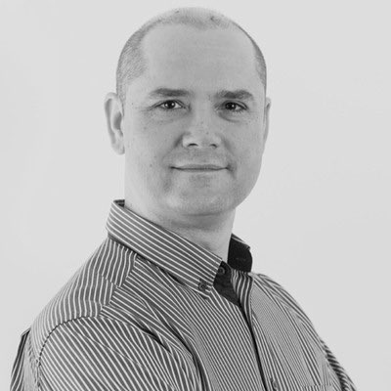
Rob Jackson
“Volunteers want to make a difference and not have their time wasted. We need to get better at demonstrating their impact so they can easily see the former, because it is immediately obvious if we are doing the latter.”
© Rob Jackson - Rob Jackson Consulting

Slide 43
Volunteer Hours Report
YEAR HOURS TREES
2022 10,000 1,000,000
2021 9,000 1,000,000 2020 8,000 1,000,000
Supplier Expense Hours Report
YEAR EXPENSE TREES
2022 $10,000 1,000,000
2021 $9,000 1,000,000 2020 $8,000 1,000,000
Notes:
RE-state the poll results

Slide 44
Volunteer Hours Report
YEAR HOURS TREES
2022 10,000 1,000,000
2021 9,000 1,000,000 2020 8,000 1,000,000
Supplier Expense Hours Report
YEAR EXPENSE TREES
2022 $100,000 1,000,000
2021 $90,000 1,000,000 2020 $80,000 1,000,000

Slide 45
Volunteer Hours Report
YEAR HOURS TREES
2022 10,000 1,000,000
2021 9,000 1,000,000 2020 8,000 1,000,000
Ts/HOUR 100
111
125
Supplier Expense Hours Report
YEAR EXPENSE TREES
2022 $10,000 1,000,000
2021 $9,000 1,000,000 2020 $8,000 1,000,000

Slide 47
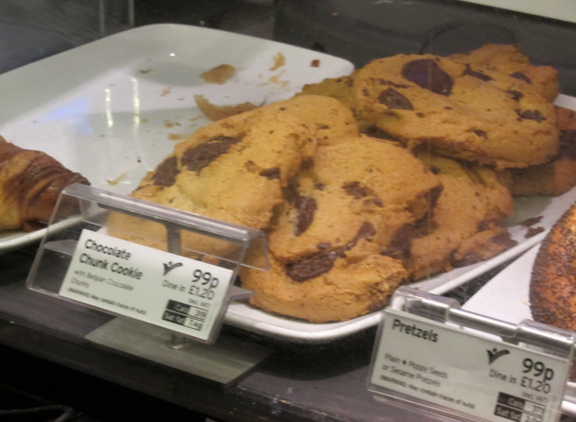
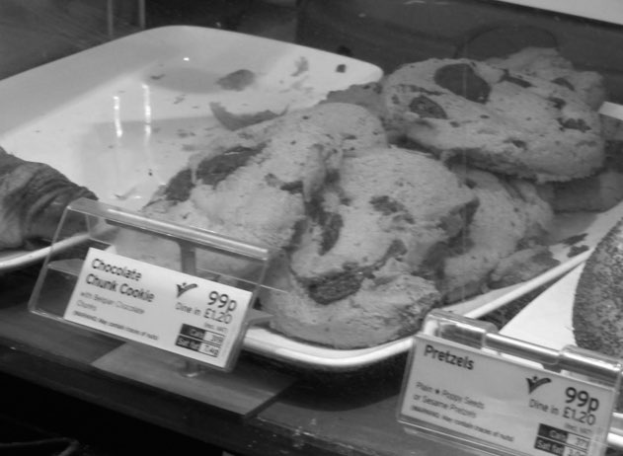
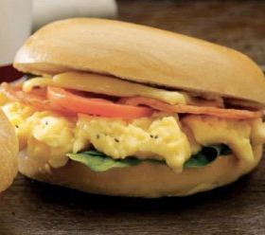
Notes:
There is what is know as an opportunity cost associated with our volunteer placements that get uncovered when we look beyond the simple hours reporting

Slide 48
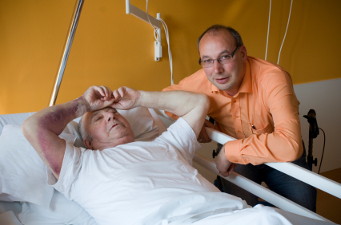
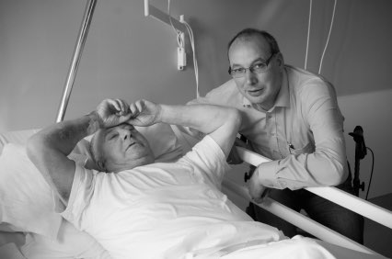
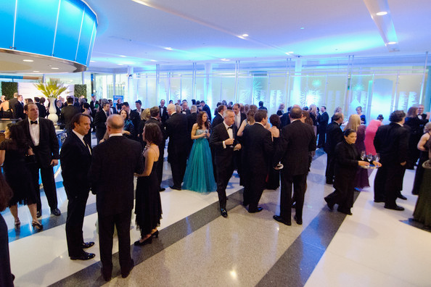
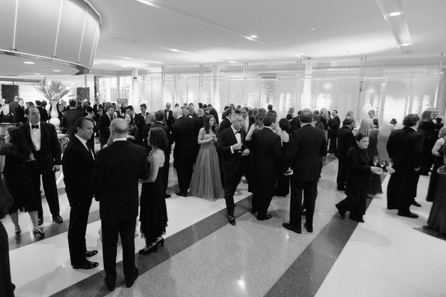

Slide 49
Volunteer Hours Report
YEAR HOURS TREES
2022 10,000 1,000,000
2021 9,000 1,000,000 2020 8,000 1,000,000
Notes:
TO demonstrate how out of sync this is with the notion of of us recognizing the value of someone’s time…

Slide 50
Volunteer Hours Report
YEAR HOURS TREES
2022 10,000 1,000,000
2021 9,000 1,000,000 2020 8,000 1,000,000
Supplier Expense Report
YEAR EXPENSE TREES
2022 $100,000 1,000,000
2021 $90,000 1,000,000 2020 $80,000 1,000,000

Slide 52
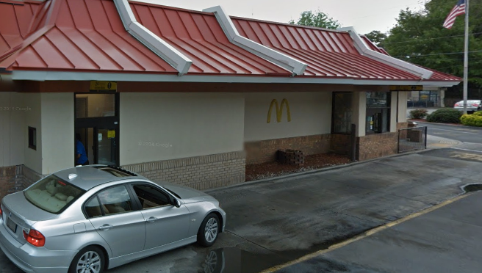
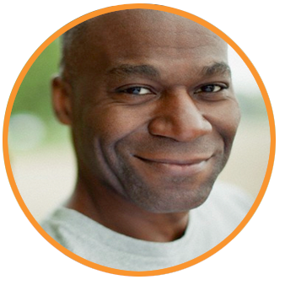

Slide 53
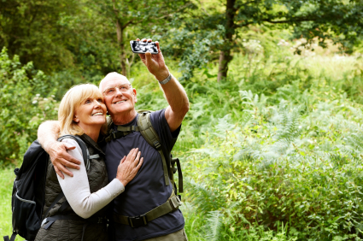

Slide 56
Fast Food Restaurant - 7 hours
Volunteer Organisation - 10 hours
This represents spending volunteer time as if it has no value.

Slide 57
Notes:
over 3 a hour shift traffic dies off after the first two hours - redo your schedule so that two people are on 12-2 and only two on 2 on 2-3 - That would reduce hours and keep the beneficial value to the hospital the same One person leave the desk
5. In what percentage of your volunteer rolls MIGHT there be an opportunity to reduce the volunteer hours while keeping the beneficial value the same, or keep the hours the same but enable the volunteer to be able to accomplish more in the time they contribute?
0-5%
6-25%
26-50%
51-75%
76-100%

Slide 58
Questions?
$100
Shopper B
Notes:
For reporting value to the community, focus on OUTPUTS rather than inputs.
Treat volunteer time as something you SPEND.

Slide 59
Takeaways
For reporting value to the community, focus on OUTPUTS rather than inputs.
Treat volunteer time as something you SPEND.
Volunteer time should be included, but as an INPUT rather than an output.

Slide 60
Dr Sue Carter Kahl
“Focusing on wage replacement values positions volunteer contributions as an output of the organization rather than as an input that helps the organization achieve its mission.”
Notes:
TO put it another way, most organizations do not exist to engage volunteers., they exist to accomplish a mission they engage volunteer to help accomplish that mission. As such, as much a possible, it’s the contribution to the missions that we should be measuring and reporting.

Slide 61
Dr Sue Carter Kahl
“Wage replacement totals can lead to the mistaken conclusion that volunteer value is equivalent to dollars saved.” © Dr Sue Carter Kahn

Slide 62
INPUTS
 |  | WRV | CBV
Volunteer hours | 1,000 | $30 | $30,000
OUTCOMES
 |  | SRV | BV
Rides provided (an output) | 800 | $50 | $40,000
Added value (an output) | 800 | $25 | $20,000
Value of the rides |  |  | $60,000
THE NET BENEFIT (Outputs - Inputs)
$30,000
WRV = Wage Replacement Value SRV = Service Replacement Value CBV = Community Benefit Value

Slide 63
INPUTS
 |  | WRV | CBV
Volunteer hours | 1,000 | $30 | $30,000
OUTPUTS
 |  | SRV | CBV
Rides provided (an output) | 800 | $50 | $40,000
Added value (an output) | 800 | $25 | $20,000
Value of the rides |  |  | $60,000
THE NET BENEFIT (Outputs - Inputs)
$30,000
WRV = Wage Replacement Value SRV = Service Replacement Value CBV = Community Benefit Value

Slide 64
INPUTS
 |  | WRV | CBV
Volunteer hours | 1,000 | $30 | $30,000
OUTPUTS
 |  | SRV | CBV
Rides provided (an output) | 800 | $50 | $40,000
Added value (an output) | 800 | $25 | $20,000
Value of the rides |  |  | $60,000
THE NET BENEFIT (Outputs - Inputs)
$30,000
WRV = Wage replacement value SRV = Service replacement value CBV = Community Benefit Value
Notes:
Wage replacement value - The Current Estimated National Value of Each Volunteer Hour Is $29.95

Slide 65
INPUTS
 |  | WRV | CBV
Volunteer hours | 120 | $30 | $3,600
WRV = Wage Replacement Value SRV = Service Replacement Value CBV = Community Benefit Value

Slide 66
INPUTS
 |  | WRV | CBV
Volunteer hours | 120 | $30 | $3,600
OUTPUTS
 |  | SRV | CBV
Dog walks provided | 500 | $25 | $12,500
WRV = Wage Replacement Value SRV = Service Replacement Value CBV = Community Benefit Value

Slide 67
INPUTS
 |  | WRV | CBV
Volunteer hours | 120 | $30 | $3,600
OUTPUTS
 |  | SRV | CBV
Dog walks provided | 500 | $25 | $12,500
THE NET BENEFIT (Outputs - Inputs)
$8,900
WRV = Wage Replacement Value SRV = Service Replacement Value CBV = Community Benefit Value

Slide 68
INPUTS |  |  | WRV | CBV
Volunteer hours | 3 |  | $30 | $90
OUTCOMES
Doctors | 30 | x | Doctor’s wage for 2 minutes | $83
Nurses | 100 | x | Nurse’s wage for 2 minutes | $37
Orderlies | 75 | x | Orderly’s wage for 2 minutes | $30
Administrators | 10 | x | Admin’s wage for 2 minutes | $20
Total |  |  |  | $170
THE NET BENEFIT (Outputs - Inputs)
$80
Notes:
Poll 4

Slide 69
INPUTS |  |  | WRV | CBV
Volunteer hours | 3 |  | $30 | $90
OUTPUTS >> OUTCOMES
Doctors | 30 | x | Doctor’s wage for 2 minutes | $83
Nurses | 100 | x | Nurse’s wage for 2 minutes | $37
Orderlies | 75 | x | Orderly’s wage for 2 minutes | $30
Administrators | 10 | x | Admin’s wage for 2 minutes | $20
Total |  |  |  | $170
THE NET BENEFIT (Outputs - Inputs)
$80
Notes:
Poll 4

Slide 70
INPUTS |  |  | WRV | CBV
Volunteer hours | 3 |  | $30 | $90
OUTPUTS >> OUTCOMES
Doctors | 30 | x | Doctor’s wage for 2 minutes | $83
Nurses | 100 | x | Nurse’s wage for 2 minutes | $37
Orderlies | 75 | x | Orderly’s wage for 2 minutes | $30
Administrators | 10 | x | Admin’s wage for 2 minutes | $20
Total |  |  |  | $170
THE NET BENEFIT (Outputs - Inputs)
$80
Notes:
Poll 4

Slide 71
INPUTS |  |  | WRV | CBV
Volunteer hours | 3 |  | $30 | $90
OUTPUTS >> OUTCOMES
Doctors | 30 | x | Doctor’s wage for 2 minutes | $83
Nurses | 100 | x | Nurse’s wage for 2 minutes | $37
Orderlies | 75 | x | Orderly’s wage for 2 minutes | $30
Administrators | 10 | x | Admin’s wage for 2 minutes | $20
Total |  |  |  | $170
THE NET BENEFIT (Outputs - Inputs)
$80
Notes:
Poll 4

Slide 72
Takeaways
For reporting value to the community, focus on OUTPUTS rather than inputs.
Treat volunteer time as something you SPEND.
Volunteer time should be included, but as an INPUT rather than an output.
Notes:
The beneficial value to the community is more accurately reported as the output of volunteer activity rather than the input of volunteer hours.

Slide 73
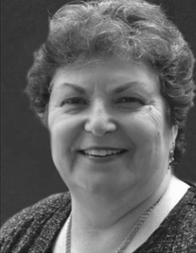
Susan J Ellis
“A single minded focus on reporting more hours leads to poor volunteer management practices.”
From a conversation with Sue at the Point of Light Conference 2013

Slide 74
Questions?
$100
Shopper B

Slide 75
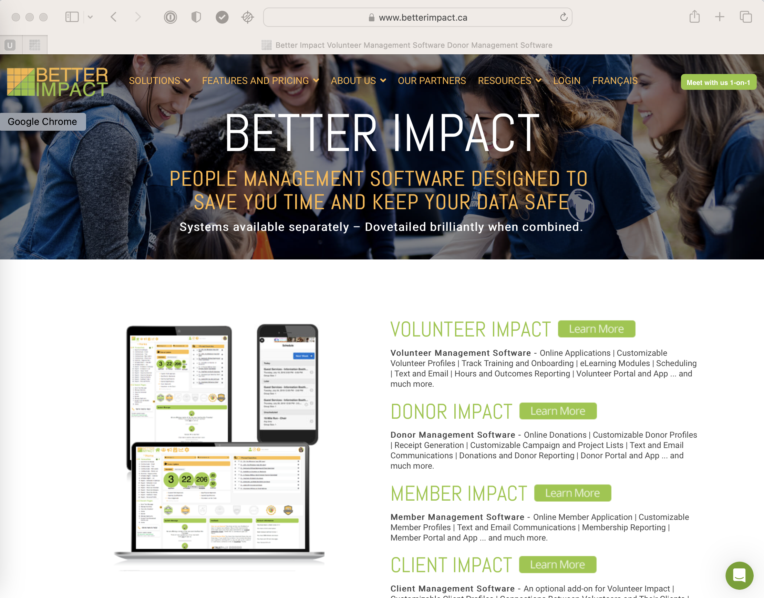
betterimpact.com

Slide 76
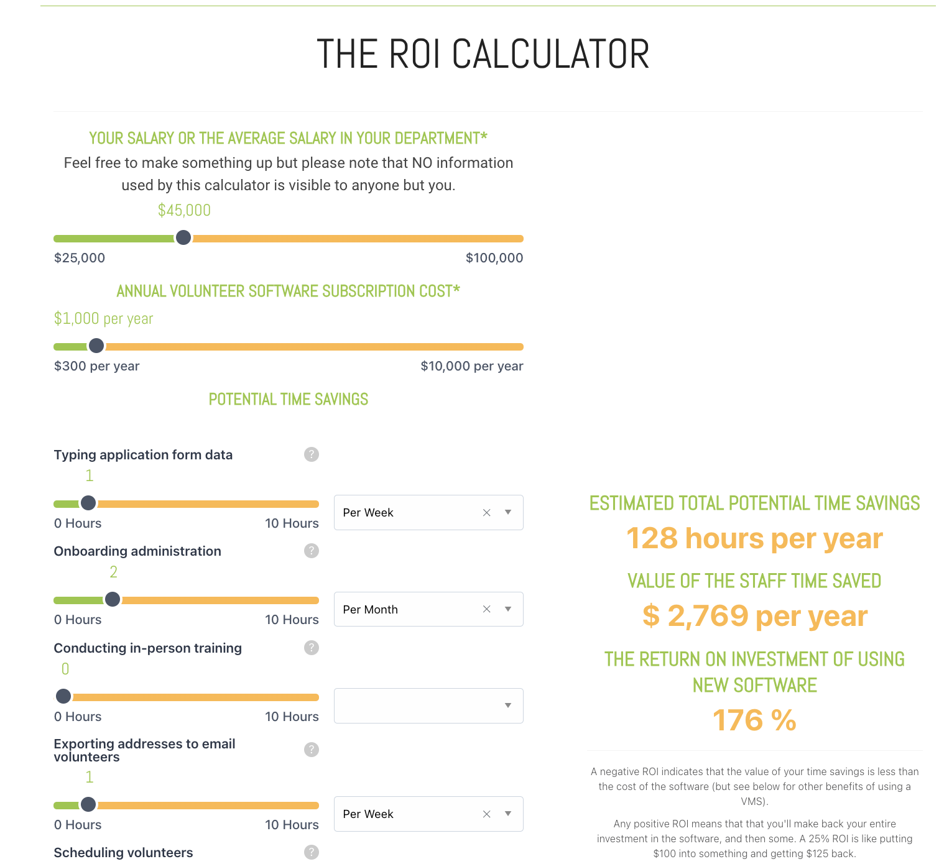
$100
Shopper B

Slide 77
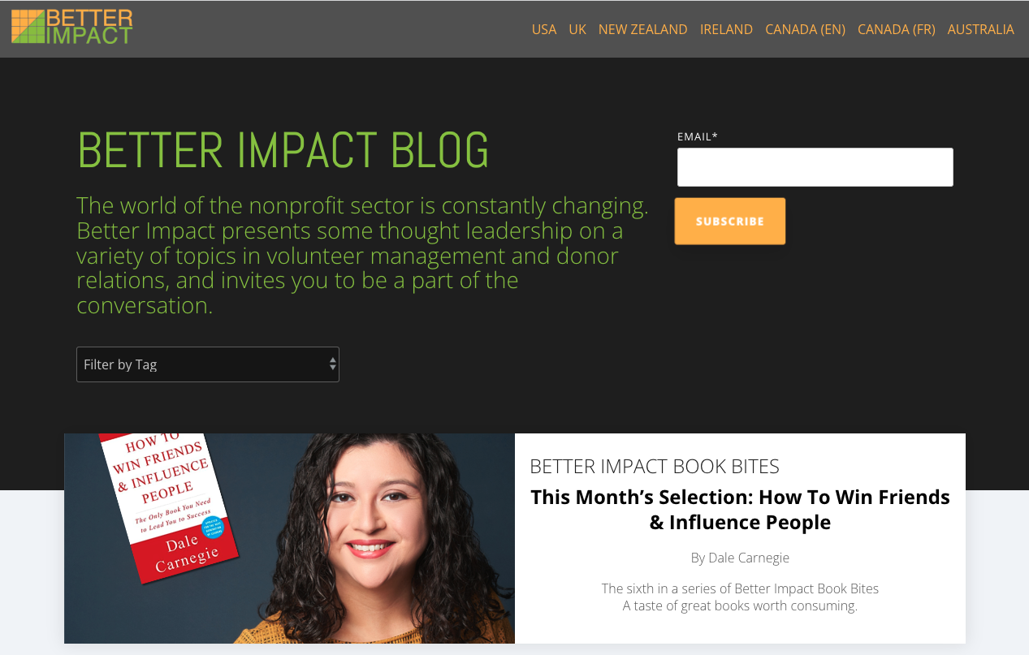
$100
Shopper B

Slide 78
$100
Shopper B

Slide 79
$100
Shopper B

Slide 80
$100
Shopper B

Slide 81
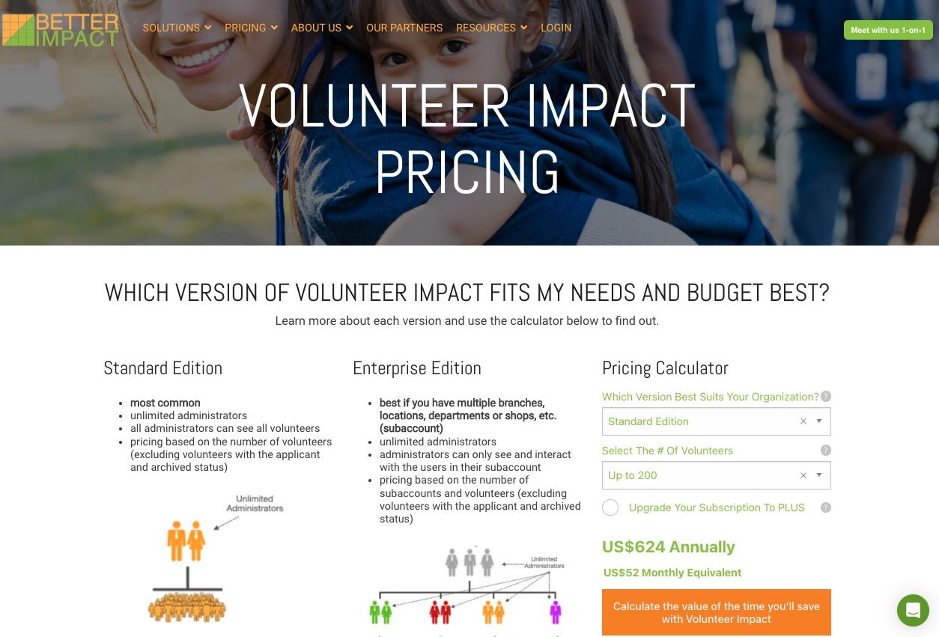
$100
Shopper B

Slide 82
$100
Shopper B

Slide 83
$100
Shopper B

