Slide 1
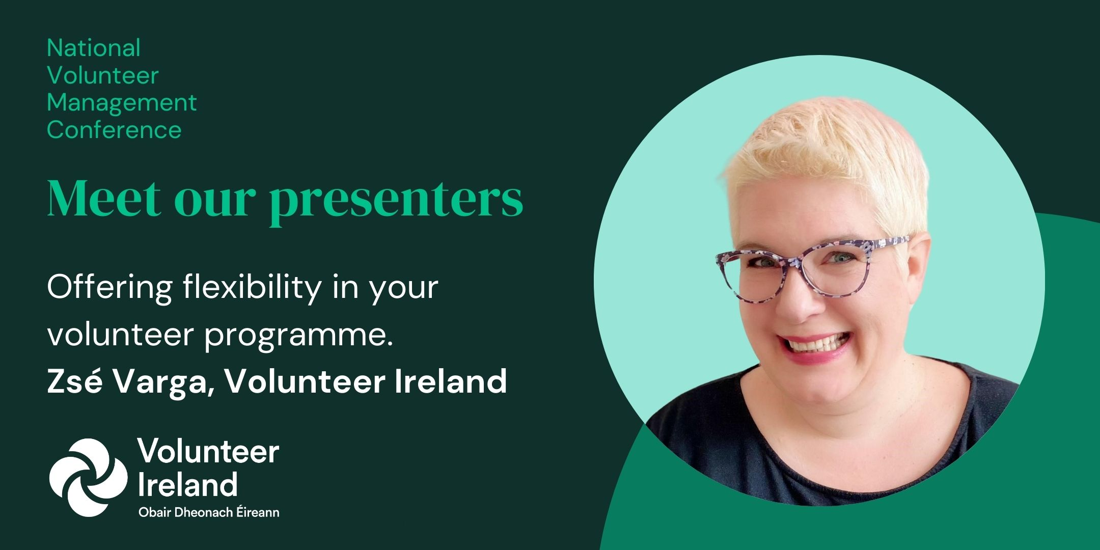
Interim i-VOL email solutions
Campaign Monitor and Mailchimp

Slide 2
Take a stance
Volunteers are hard to recruit these days.

Slide 3
Take a stance
Without volunteers, my organisation’s services would be poorer or not as rich.

Slide 4
Take a stance
Volunteers should commit to a minimum service time after their garda vetting and training, so our resource investment is worth it.

Slide 5
Take a stance
We already have some flexibility in our volunteer programme.

Slide 6
Take a stance
Flexibility in volunteering allows matching my organisation’s needs with the needs of the volunteers, in creative ways.

Slide 7
Be a consultant for a day
You are a highly paid expert consultant on flexible volunteer engagement.
You have been contracted by this illustrious charity that works in an specific area.
Your role is to assist in introducing more flexibility in their volunteer engagement.
Discuss ways to make the volunteer programme more flexible and inclusive
Don’t just list roles;
List procedures or practices or even organisational culture that could/should be changed
Record as many ideas on the paper provided as you can think of – the good, the bad and the ugly
You have 10 minutes
Select a spokesperson for brief feedback to share the 3 best ideas

Slide 8
Pick up ideas
Share an idea you have just learnt, and you could
Try
Change
Do
in your own organisation.

Slide 9
Take away
Note three ideas
as takeaways about
flexibility in volunteering
Zsé Varga
Volunteer Ireland
zse@volunteer.ie
www.volunteer.ie

Slide 10
 | Campaign Monitor | Mailchimp
Delivers email | Yes | Yes
Manage email lists | Yes | Yes
Filter the email lists | Workaround required | Yes
Manage unsubscribes | Yes | Yes
Syncs email activity | Not fully | Yes
Additional functionality | Workaround required | Yes
Keeps users in i-VOL | Yes | No

