Slide 2
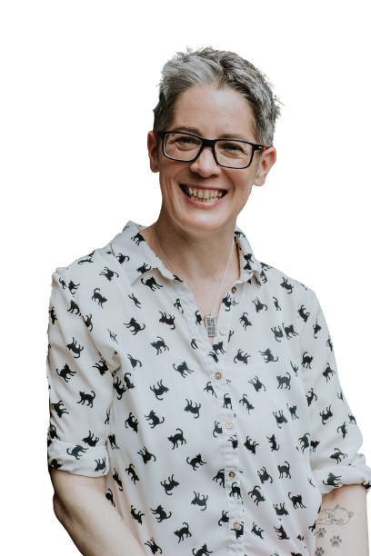
Jo Gibney, Life-Work Balance Coach
Life-Work Balance Coach, helping charity workers find their life-work blend, set boundaries, and steer clear of burnout
Head of Business Development for the UK’s Association of Volunteer Managers (AVM) for 3 years, and previously a Director of AVM for 2 years
Volunteer Management roles as national UK organisations for 8 years
Notes:
I’m Jo Gibney, a life and career coach. I particularly enjoy helping people find the blend of life and work they want, set boundaries and build habits that allow them to say yes to more of what they love, and steer clear of burnout.
I help busy, people-focused professionals - like volunteer managers - as having ‘customers’ - whether they are customers, volunteers, clients or internal stakeholders - comes with a higher pressure to say yes and people please, higher expectations and demands, as well as having to deal with other people’s emotions. All of which can lead to burnout.
Prior to becoming a coach, I worked for the UK’s Association of Volunteer Managers, and was a volunteer manager before that, so I understand the pressures volunteering professionals face.

Slide 3
Advocating For Your Volunteer Programme

Slide 4
What will we cover?
Know and understand the vision
Know who you need to influence
Know how and what to you need to communicate well
Know what you can control and influence
Notes:
Knowing and understanding the vision
Knowing who you need to influence
Know how and what to you need to communicate well
Knowing what you can control and influence

Slide 5
Know and understand the vision
Notes:
Before you can start to advocate for volunteering in your organisation, you need to have an understanding of what your organisation is there to achieve? And therefore, how does volunteering fit into the wider organisational purpose and strategy.
The clearer you are on this, the better able you are to communicate the value of volunteers and volunteering.
It may not be your role to write a volunteering strategy, or contribute to your organisational strategy, but it’s important to know them both and how they link. I’m not going to go into strategy development - that’s not what we’re here to discuss. Instead, I’m going to ask you a question:
“Do you know how volunteering contributes towards your organisational vision?”
Before you can start to advocate for volunteering in your organisation, you need to have an understanding of what your organisation is there to achieve? And therefor, how does volunteering fit into the wider organisational purpose and strategy.
The clearer you are on this, the better able you are to communicate the value of volunteers and volunteering.
It may not be your role to write a volunteering strategy, or contribute to your organisational strategy, but it’s important to know them both and how they link. I’m not going to go into strategy development - that’s not what we’re here to discuss. Instead, I’m going to ask you a question:

Slide 6
Action
What one thing can you do this week to improve your knowledge and understanding of how volunteers contribute to the vision and mission of your organisation?
Notes:
Action. What one thing can you commit to doing this week to improve your knowledge and understanding of how volunteers contribute to the vision and mission of your organisation?
Maybe you’ll:
Commit to a date by which you will read the organisational strategy and make notes on how volunteering supports this
Find and book a volunteering policy training course with Volunteer Ireland
Book in a meeting with your manager or team to discuss how volunteering links to the wider organisational strategy, or how you can be more involved in a the volunteering strategy
I’ll give you a couple of minutes to write this one thing down.

Slide 7
Know who you need to influence
Notes:
Question: What’s the importance of knowing your stakeholders?
Once you have - or while you are working on developing a better understanding, you also need to think about who you need to influence. Because unless you’re the Chief Executive, on the senior leadership team, or a trustee, you probably don’t have enough power or influence to get budgets signed off, start new projects, launch new volunteer roles. Again, frustrating!
Stakeholder identification - also known as stakeholder analysis or stakeholder mapping - is a way of identifying the people who have the power and/or influence to help you advocate for your volunteer programme.
There are many stakeholder analysis tools available. Today I’m sharing two I find useful.
On your tables, let’s spend five minutes starting to mapping out your stakeholders. You can use the table in the worksheet, or draw your own table.

Slide 8
Who are your stakeholders?
High Power / Low Influence | High Power / High Influence
Low Power / Low Influence | Low Power / High Influence

Slide 9
Who’s in your network?
Outer Circle
Friendly
Inner Circle
YOU

Slide 10
Action
What one thing do you need in order to complete your stakeholder analysis?

Slide 11
Know how and what to you need to communicate well

Slide 12
Communicating at your best
Environment | Behaviour | Skills | Beliefs and Values | Identity and Purpose
What environment supports you to communicate at your best? | What behaviours support you to communicate at your best? | What are you already good at that supports you to communicate at your best? | What do you believe and value that helps you communicate at your best? | Who do you want to be that enables you to communicate at your best?

Slide 13
“Good stories surprise us. They make us think and feel. They stick in our minds and help us remember ideas and concepts in a way that a PowerPoint crammed with bar graphs never can.”
Joe Lazauskas and Shane Snow, ‘The Storytelling Edge’

Slide 14
Communication preferences
Understanding how people prefer to receive information in order to make decisions, will make you better at tailoring your communication to be more effective.
Understanding how you prefer to communicate, will help you see where you might need to adapt your approach, in order to be more effective at advocating.

Slide 15
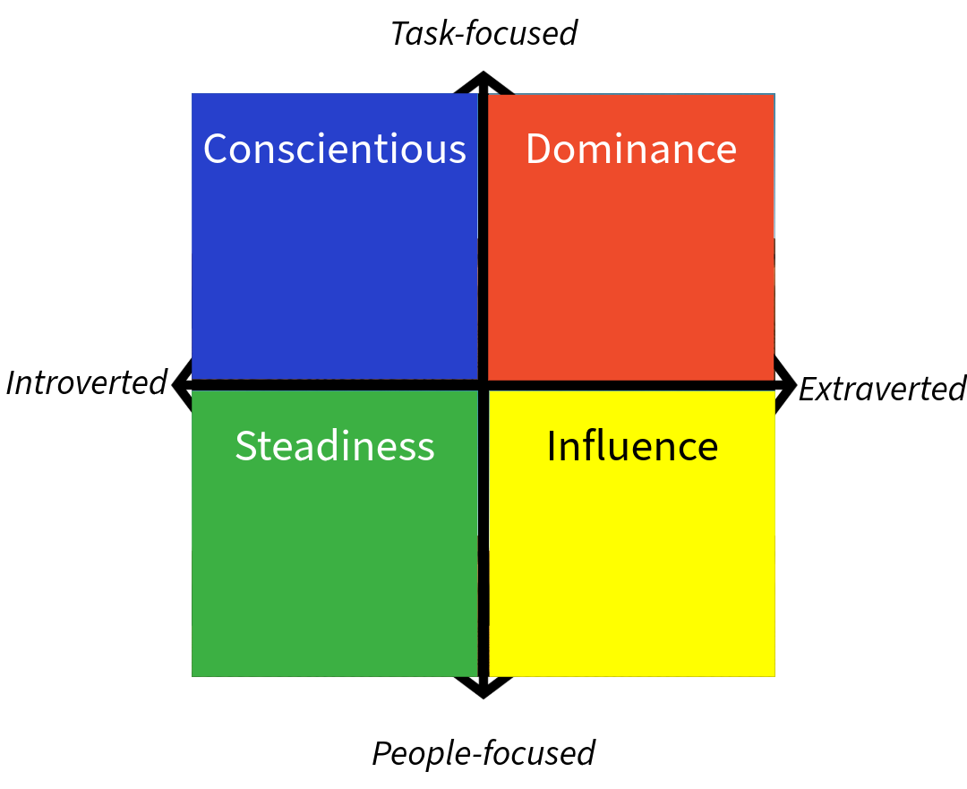
DISC, Insights, Myers-Briggs preferences

Slide 16
Reflection
Thinking about yourself: what are your preferences when giving and receiving information?
Thinking about your manager or someone you want to influence: what are their preferences when it comes to giving and receiving information?
Thinking about your situation: how might you need to adapt your communication style in order to better advocate to those of a different preference?

Slide 17
Know what you can control and influence

Slide 18
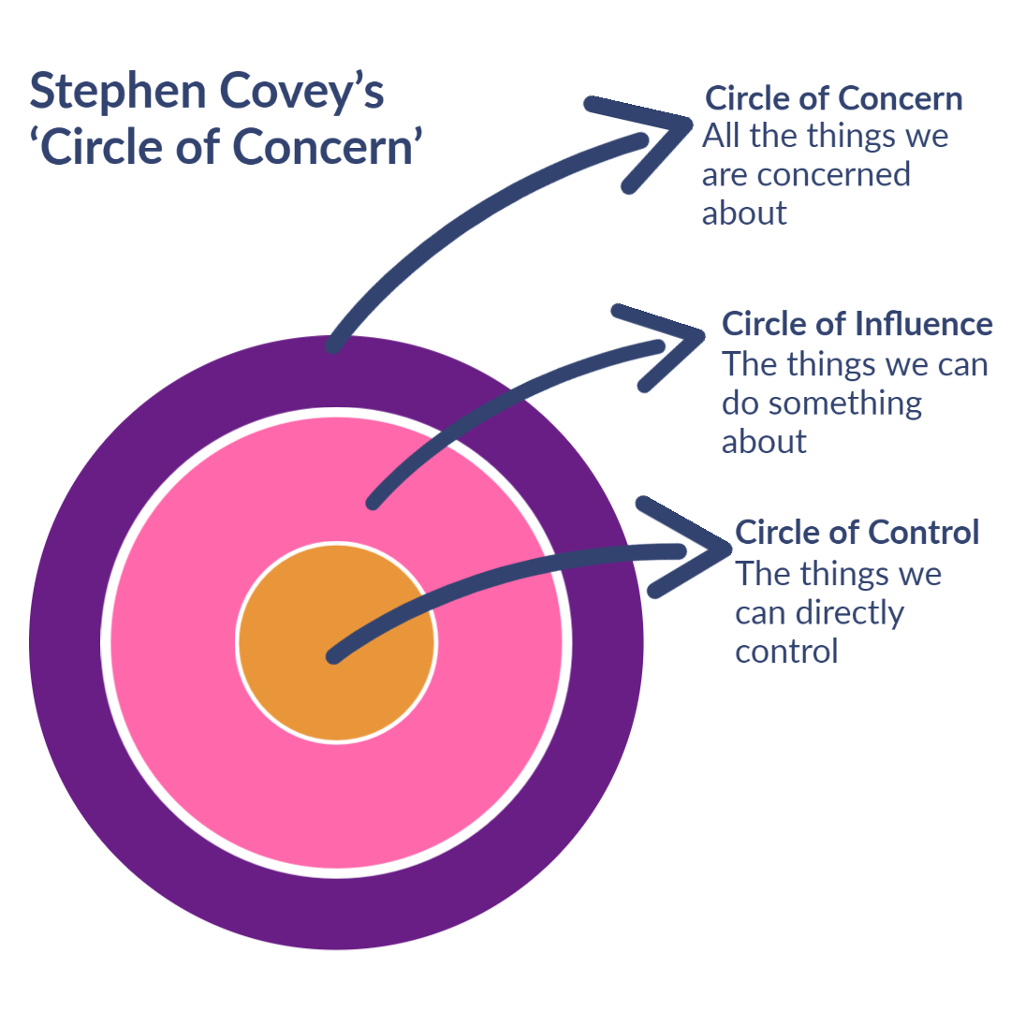
What are you concerned about?
What or who can you influence?
What can you control?
How will you manage the things you can’t control or influence?

Slide 19
Q&A

Slide 20
Three takeaways
What’s one thing you can do this month to help you feel more confidence to advocate?
Who or what can support you with that?
What do you need to stop doing to support you with that?

Slide 21
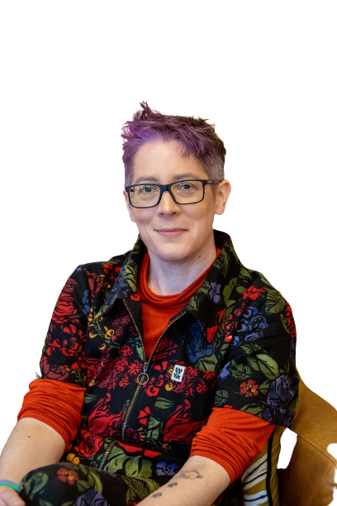
Jo Gibney, Life-Work Balance Coach
Helping you:
Figure out what your version of what success looks like
Have the life-work blend you want
Set boundaries and say yes to more of what you love
Steer clear of burnout
LinkedIn: https://www.linkedin.com/in/jogibney/

