Slide 2
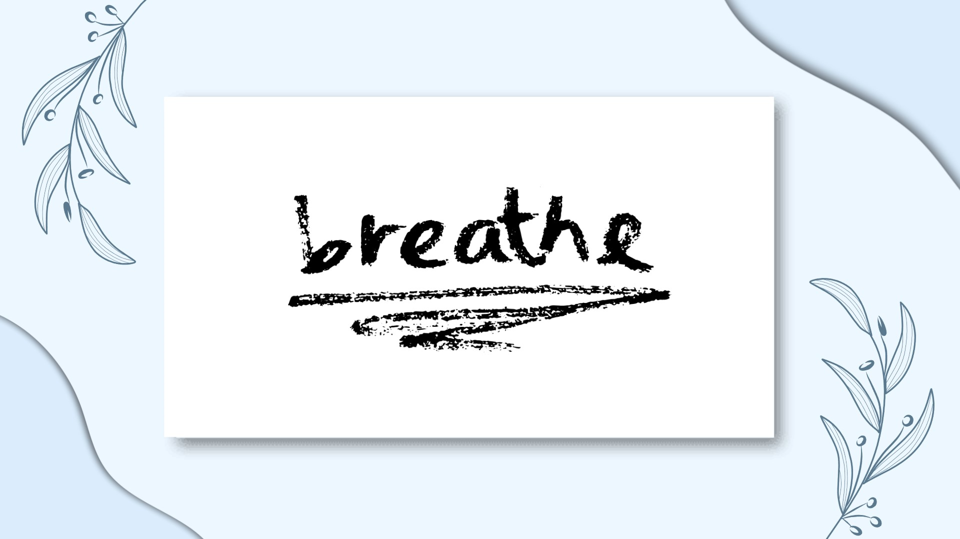
Jenna Walsh
Mayo Mental Health Association
Notes:
Breathe was developed by Mayo Mental Health Association to give an overview of the work of Mayo Mental Health Association and to gain an understanding of Mental Health and Wellbeing
Story About picture

Slide 3
So, what is Mental Health?
Notes:
Ask the participants to come up with one example of each of the first thing that comes into their head when they hear Mental Health and discuss
In this unit we explore what the term ‘mental health’ means to us in our everyday lives.
Mental Health is our ability to respond to challenges

Slide 4
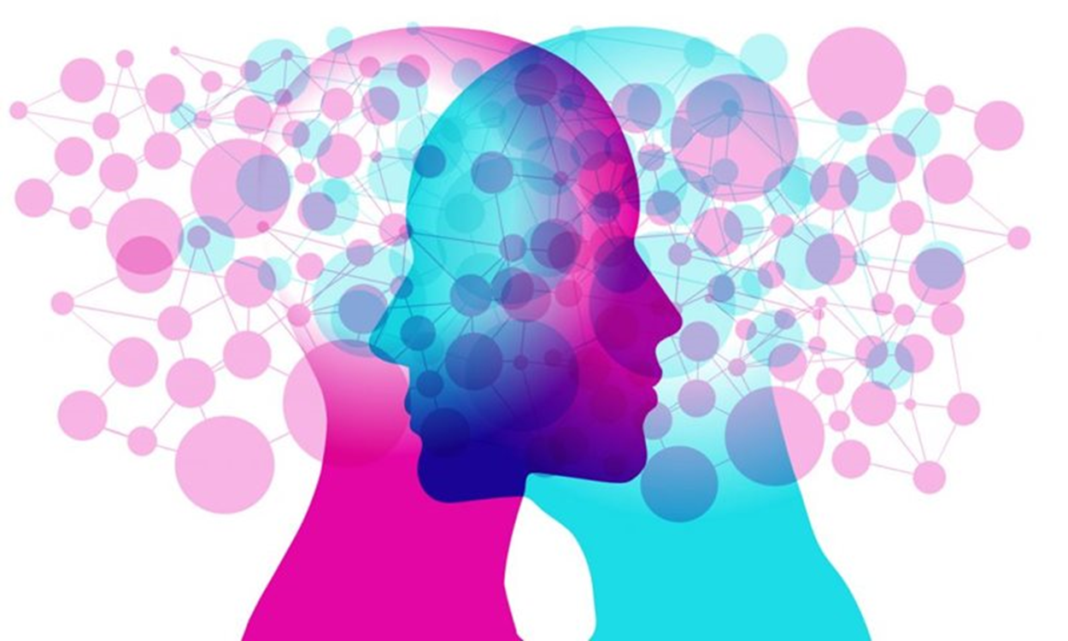
Mental ILLNESS
MENTAL HEALTH
Notes:
MH < -----|-----|-----|-----|-----|------|-----> MI
All tipping along on a scale
If we don’t look after our MH, sometimes, but not all the time, it can lead to mental illness
Everyone has mental health but not everyone has mental illness
Sometimes when people hear the words mental health they automatically think of mental illness, but this isn’t always the case

Slide 5
World Health Organisation
Mental health is defined as a “state of well-being in which every individual realizes his or her own potential, can cope with the normal stresses of life, can work productively and fruitfully, and is able to make a contribution to her or his community”.
Notes:
In simpler terms, we all have a role to play, and no role is more important than anybody else’s
Doesn’t matter where on the team you play, what grades you get, who you’re friends with; nobody is more important than anybody else
And MH doesn’t favour anybody; whether you’re Ronaldo, Aidan O’Shea, Ekin-su, me, YOU
As I said, every single one of us has MH, and it’s so important to look after it because sometimes, not all the time, it can lead to mental illness
Take physical health for example. If you had a problem with your PH you’d go to the likes of a doctors, physiotherapist, hospital to get help
It should be the same for mental health. There are different services you can avail of to help with MH, and I will highlight some of this in a little bit

Slide 6
Who is the strongest person in the room?
Notes:
Ask two people up to top of the room and carry out experiment. This is demonstrate that sometimes something so small can become unberable if we don’t know how to deal with it
Youtube different activities

Slide 7
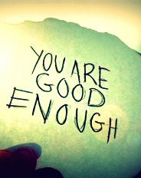
Relationship with yourself
Notes:
MH IS ABOUT 3 THINGS HERE AT THE ASSOCIATION

Slide 8
Relationship with others
Notes:
Community wellbeing
You can’t have a good relationship with others if you don’t have a good relationship with yourself.

Slide 9
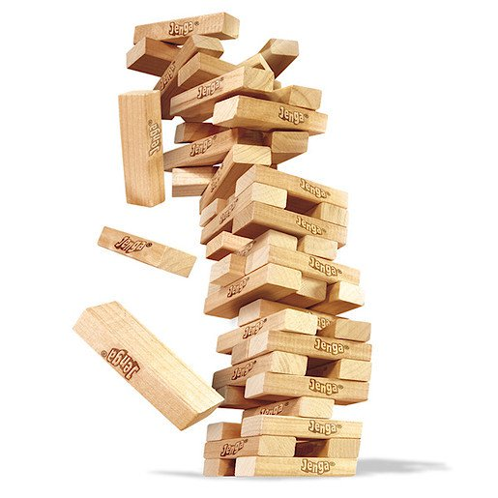
ABILITY TO COPE WITH LIFE’S CHALLENGES
Notes:
It’s about how you pick yourself back up

Slide 10
3 + 1 = 4
4 + 4
= 8
5 + 4 = 9
1 + 1
= 2
7 + 7 = 14
5 + 6
= 13
Notes:
Ask yourself how long would you spend thinking about that one thing that went wrong
Example of myself…

Slide 11
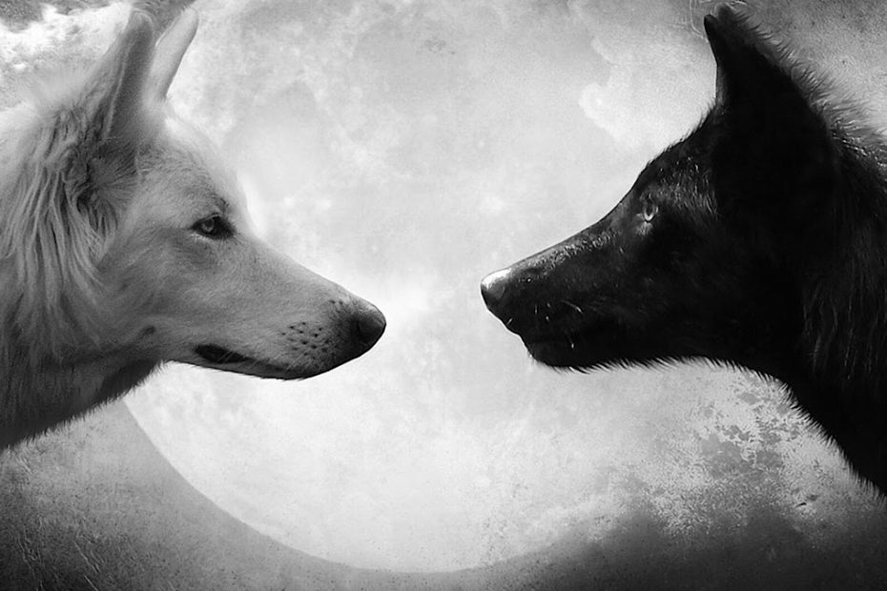

Slide 12
Unit 2
Risk and Protective factors

Slide 14
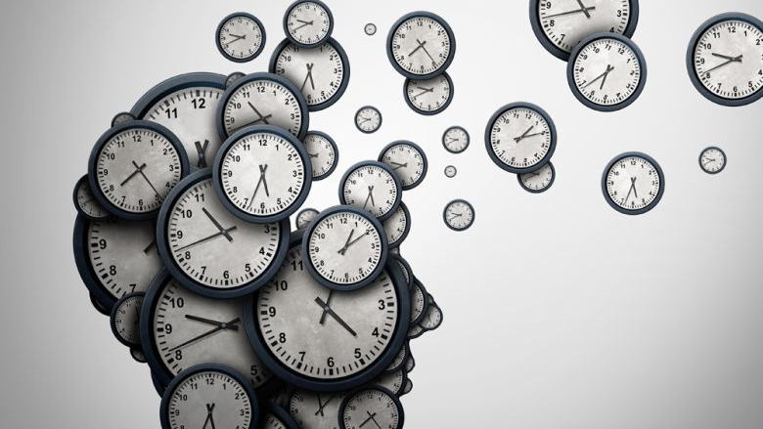
Notes:
Exercise…..weighing scales/tug of war

Slide 16
Unit 3
SIGNS & SUPPORTS

Slide 18
Supports
Notes:
Ref:https://www.mindhealthconnect.org.au/signs-mental-health-issue
Ref: Mayo MHA.ie

Slide 20
“YOUR MENTAL HEALTH BELONGS TO YOU!
MIND IT, SHARE IT, BUT ABOVE ALL,
DON’T HIDE IT!”
- Mayo MHA

