Slide 1
Notes:
Hi everyone, my name is Eva Blackwell and I am a Youth Advocate volunteer for Jigsaw, the national youth centre for mental health. I have also experienced volunteering on the Action Panel for Spun-out and for Asiam. I am here today with Lauren Sweeney from Volunteer Ireland to talk a little bit about our perspective on volunteering as young people. Lauren will now tell you all about the partnership building activity we participated in recently.
Thank you Eva. My name is Lauren and I work for Volunteer Ireland now and I have been involved in different types of volunteering over the years, mostly in my local rugby club and with the DSPCA.

Slide 2
KA2 Partnership Building Activity
Title: ‘What a Youth Job Culture Would Look Like’
Location: Vilanova, Spain
Notes:
Eva and I actually met last month on an Erasmus+ project. For those that aren’t familiar with the Erasmus+ Programme it is the EU's grant programme in the fields of education, youth and sports. It supports education, training, internship, professional development, youth activities and cooperation between institutions.
There are multiple Key Actions so for example Key Action 1 is learning and mobilisation of individuals, and that would include the study abroad programmes that most people are familiar with in Universities.
The project we attended was under Key Action 2: Cooperation among organisations and institutions. This action encourages co-operation and sharing of best practices. We attended a partnership building Activity titled ‘What a Youth Job Culture Would look like’ and it was focused on identifying and addressing issues of Youth Unemployment across Europe. This project consisted of presentations, information sessions, group work, brainstorming and relationship building.
This was an amazing opportunity especially for Eva and I as young people to be able to meet so many people from different countries, cultures and organisations and share information and learn from them and even make plans for the future to combat some of the issues we discussed.
We didn’t really know much about the different Erasmus+ programmes before we went but they’re actually brilliant and really facilitate learning and relationship building. The Programme is open to any organisation active in the fields of education, training, youth or sport so I would hugely encourage people to apply for funding and take part in these projects. You can talk to Leargas who has a stand here to find out more about the programme.

Slide 3
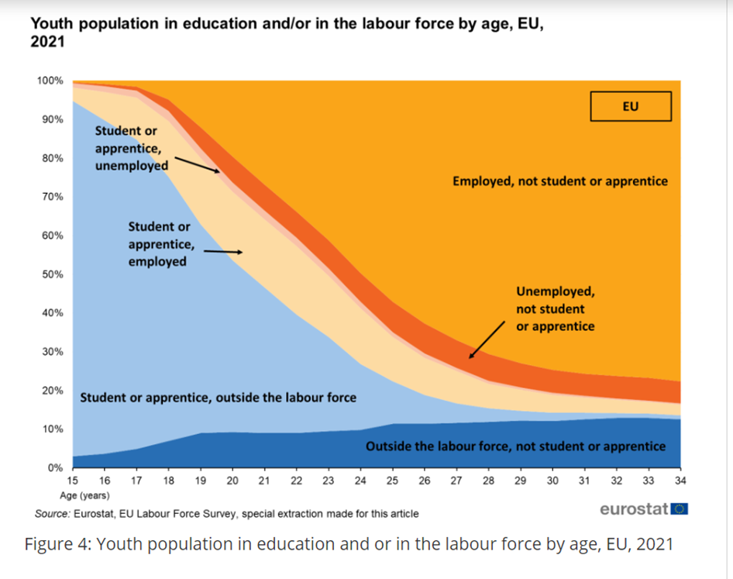
Youth Unemployment
The European Perspective
Differences across countries
Youth unemployment rate 14.8 % in the EU
(Total EU unemployment rate - 6.0 %)
Germany 5.8%
Ireland 12.8%
Greece 25%
Spain 28.2%
(February 2024)
Notes:
We looked the issue of Youth unemployment across multiple European countries under different areas such as policy, education, war and conflict.
As you can see a lot of young people aged 15 – 24. are in formal education as you’d expect. You can see as well that more students work than don’t work. However the area we were concerned with is the dark orange section ‘unemployed, not student or apprentice.
Ireland’s youth unemployment is ok in terms of the EU average at 12.8% likely due to the highly educated population. However it is much higher at 25% and upwards in Greece and Spain
The issues are obviously really complex and created by differing economic conditions across countries. For example spain’s high unemployment levels can be explained by high reliance on the tourism sector and rigid labour market regulations, that make hiring and firing difficult.
Whereas Germany’s high level of youth employment is likely interlinked with their high employment levels generally and can also be attributed to an extensive dual education system that supports vocational training and apprentiships

Slide 4
Similarities
Solutions
Governmental level
Policy changes
Investing in education
Vocational training
Implementing targeted youth employment programmes
Organisational level
Capacity Building
Training/ internships/ internal volunteer programmes
Notes:
So when we looked at it we found the issues affecting each country differed massively and have complex economic foundations, it was amazing to get a firsthand understanding of the situations across different European countries by talking to natives. We found that while the causes are different the solutions were often the same. As shown in Germany and just generally due to the nature of youth unemployment and it’s interconnection with education, solutions can be rooted in education and experience. This can be implemented on a governmental level by investing in education and specifically implementing targeted youth employment programmes. More emphasis can be put on vocational training such as apprenticeships.
We found that while a lot of the solutions are on a governmental level or should at least be supported by the government we also looked at solutions on an organisational level. At the project Eva and I presented on the benefits of volunteering, especially for young people and how this can impact employment opportunities through pathways, relationship building and acquiring of valuable skills.
Eva will talk more about how volunteering can lead to employment opportunities, particularly related to her personal experience.

Slide 5
Volunteering and Employment
Skills
Experience
Competencies
Connections
Confidence
Launching pad for career
Exploring interests and dislikes
Supportive environment
Notes:
In my time as a volunteer, I have been lucky enough to use my voice as a young person in many facets of Jigsaw's organization. They truly value and center the voice of young people in decision making big and small. This ethos allowed me to initially take part in helping my own local community, raising funds locally, talking to local politicians and advocating for our D15 hub to be more welcoming to people accessing the service. With the guidance and encouragement of my engagement worker, I was then able to branch out and bring my voice to the research team and the youth reference group who incorporated youth voice into the larger decisions taking place within the organization across Ireland. The most exciting part for me was being a part of the writing, development, roll out and showcase of the Erasmus plus and Leargas funded Amplify and Advocate project. This project consisted of youth advocates and their support systems creating local advocacy groups across various themes and looked at barriers facing young people and their mental health. My own advocacy project included a collaboration with a local Christian church, where young members from the African community brought to light the barriers they face in accessing mental health support in the form of an interview. The result of this being increased communication, understanding and a new relationship established in the community.

Slide 6
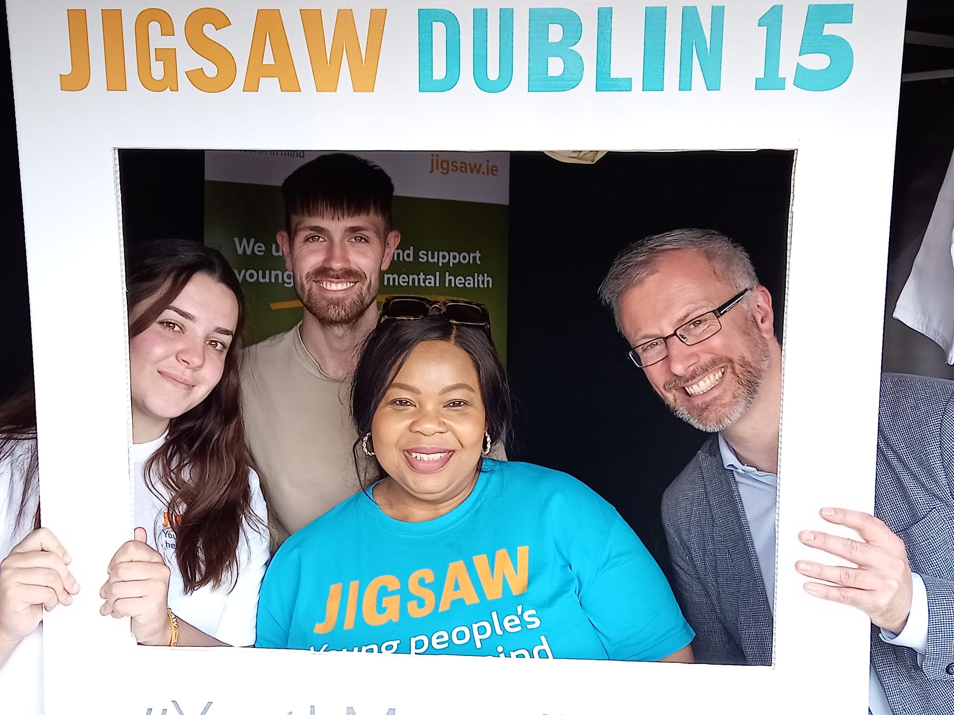
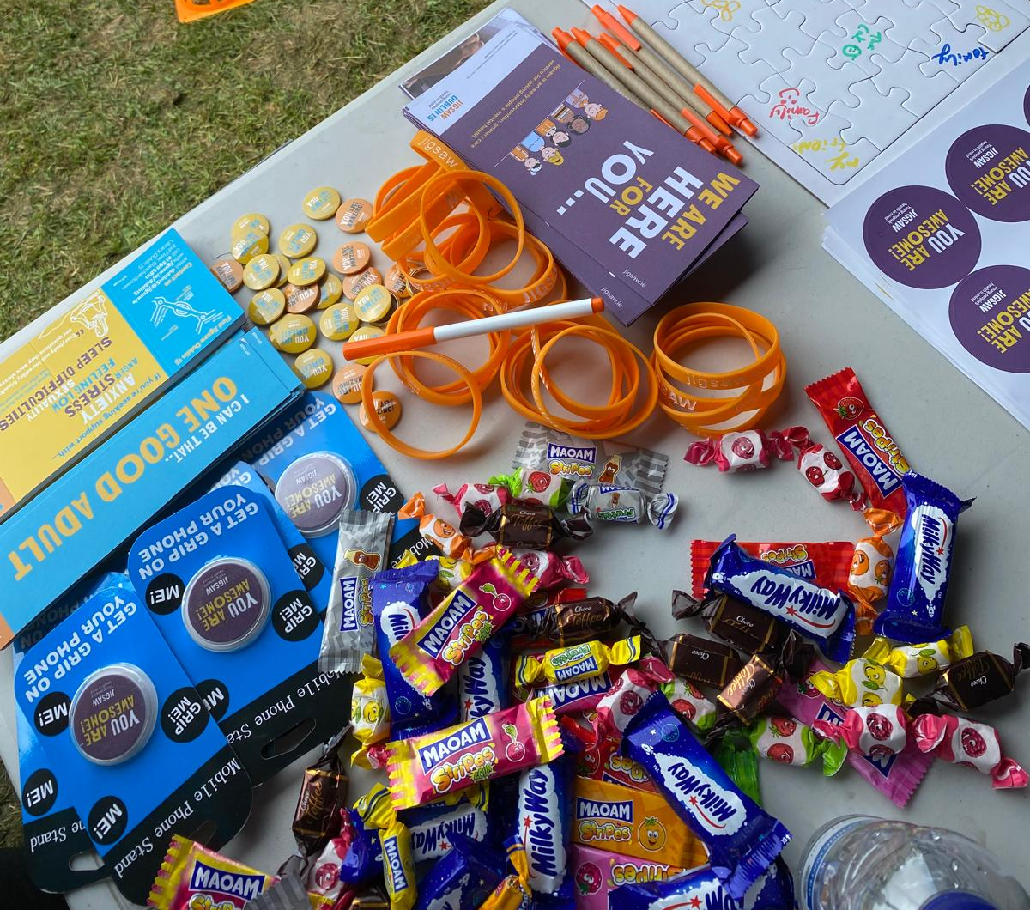
Teamwork
Professionalism
Relationship building
Project management
Independent working
Time management
Advocacy
Oral and Written Communicaiton
Problem solving
Resilience
Interpersonal skills
Organization
Active listening
Creativity
Skills
Skills
Notes:
This graph here shows you a few of the skills I consider to have gained from volunteering, some examples are advocacy, communication, time management, resilience, teamwork and much more. Skills are not the only thing that help you to gain employment, it is also the opportunity to network with other peers and professionals you would not have met otherwise. The support from my mentors has been incredible in terms of mapping out my short and long term goals and connecting me with the people that can help me achieve that goal. Capacity building has also been hugely beneficial. Being trained in public speaking, advocacy, mapping out resources in a community and non-aggressive communication built my confidence in my own ability. It also gave me an idea of what I liked and what I did not like, eventually I realized I loved working with people and advocating for them, which I believe has led me to my current employment as a project worker for the homeless. Without the help of Jigsaw and the other volunteering experiences that followed I would not be presenting here today. Once you give young people the tools, you will be pleasantly surprised with their ability to achieve many great things.

Slide 7
Engaging Young People In Volunteering
1.- Support network
One on one meetings
Goal setting
Interests and strengths,
Encouragement,
Confidence building,
Understand other commitments
Open communication
Reward their efforts.
2.- Learning
Accredited training,
Capacity building,
Career development
Assess competencies and see how they can improve. ​
Hands on learning
​
4.- Youth Voice
Valued
Centered
Taken seriously
Evaluation and feedback
3.- Connection opportunities:
Social media,
Newsletters,
Events
Peers and other professionals
Notes:
Lastly, how do we engage young people in volunteering? In my view there are several categories in engaging the young people in your organization. Firstly, having a strong support network around your young volunteer. What are their short term and long term goals? What are their interests, passions, strengths, what do they dislike? How are they getting on? Give them the confidence to keep trying new things, believe in their ability and if they are good at something or did something well, make sure to tell them! Also supporting young people is understanding the outside pressures and time commitments they may have, and communicating well about how much they can put into volunteering and how best to support them around volunteering-life balance. One thing I love about being a youth advocate, is the flexibility to sign up for what I can do. Secondly, learning for me is a hugely important part of engagement. Even though many of us volunteer out of passion for the cause, when it comes for looking for employment, accredited training, cv skills or interview skills, assessing and improving competencies, hands on learning and capacity building is especially beneficial to a young person starting out in their career and keeping them engaged in your organization. Thirdly, the opportunity to connect. This can be connecting with other professionals and peers at events, on social media or through a newsletter. Lastly, but most importantly for me, is the youth voice. Keep feedback and evaluation loops in check, making sure that young people are being heard. Young people need to know that their voice is taken seriously, valued and actively listened to. Thank you and I hope you have a nice evening.

Slide 8
Any questions?
Notes:
Any questions?

